Slide 1
Learning Management System

Slide 2
Learning Management System “LPU e-Connect” URL: https://lms.lpuonline.com/

Slide 3
LPU e-Connect (LMS)
LPU e-CONNECT FOR 24X7 ACCESS TO ACADEMIC RESOURCES
LPU e-Connect, an exceptional and user friendly online platform of Lovely Professional University, offers ANY TIME ANY WHERE strong and secure online connection that connects its students with the university.
Based on enterprising web portal technology, it truly automates various administrative and academic processes of Online Education and minimizes the shortcomings of physical distances by providing 24X7 accessibility through its various useful features.
LPU e-connect is a boon for students as they can learn as per their convenience along with their other commitments. Students enrolled under LPU Online Education are allotted a personalized User ID and Password through which they may access various interactive and dynamic features of LPU e-Connect which serves the motto "Your Education Your Way". LPU e-Connect is also accessible through various Mobile Applications.

Slide 4
LPU e-Connect (Key Methods)
Key Modules of LPU e-Connect
My Account: serving as a personalized account of the student containing student profile, ID card, Profile edit, Online Fee Payment, Fee Details etc.
e-Communication: providing information through Announcements, Personalized Messages etc.
Exam Connect: giving information regarding Draw your Datesheet, Assignment Submission, Date Sheet, Student Admit Card, Result, Grade Card and other forms etc. available thereto.
e-Content : providing access to e-books of registered courses and programme guide.
Course Connect: giving information on registered courses under “My Courses” and easy access to Course Selection interface to choose your electives/ courses as applicable in programme scheme.
e-Library: LPU e-Library System provides access to more than 20+ Lakh e-books covering all fields of knowledge. Providing access to variety of add on e-Resources, such as e-books, e-journals, e-newspapers, e-magazines etc.
e-Tutorials: course wise access to recorded videos followed by self assessments at the end of each unit, allowing student to learn at its own pace and providing easy access to Transcripts, e-Resources etc.

Slide 5
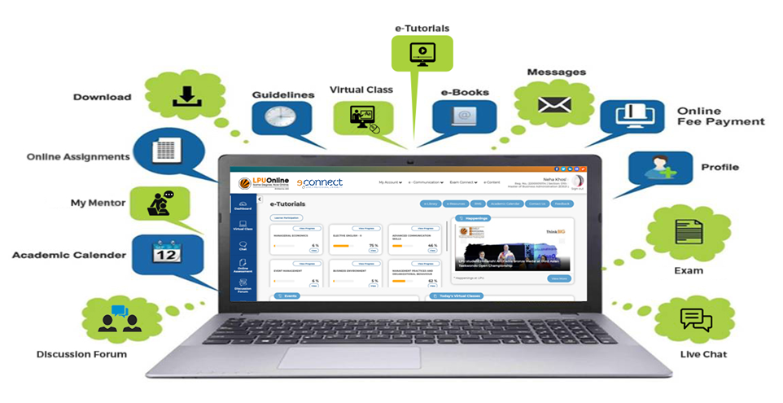
LPU e-Connect Features (Key Methods)
Virtual Class: available on one click through an exceptional user-friendly online platform and allows two-way communication wherein student can watch or listen to their course mentors, interact and even ask questions.
Chat/ Discussion forum: In order to clear the doubts of students, LPU online education provides 24x7 support by introducing a discussion forum and a chat (LPU Live) windows for helping students in addressing their doubts related to the curriculum as well as general queries and to engage student in discussion of various topics.

Slide 6
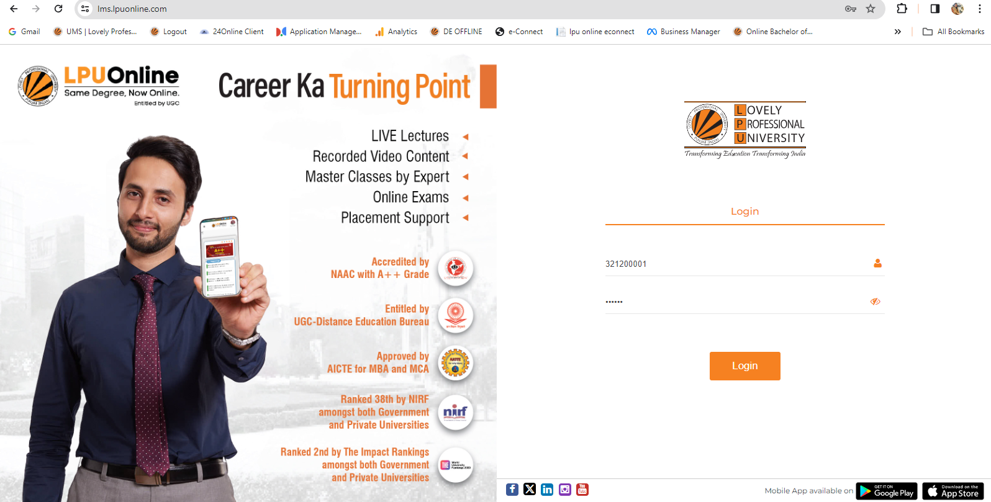
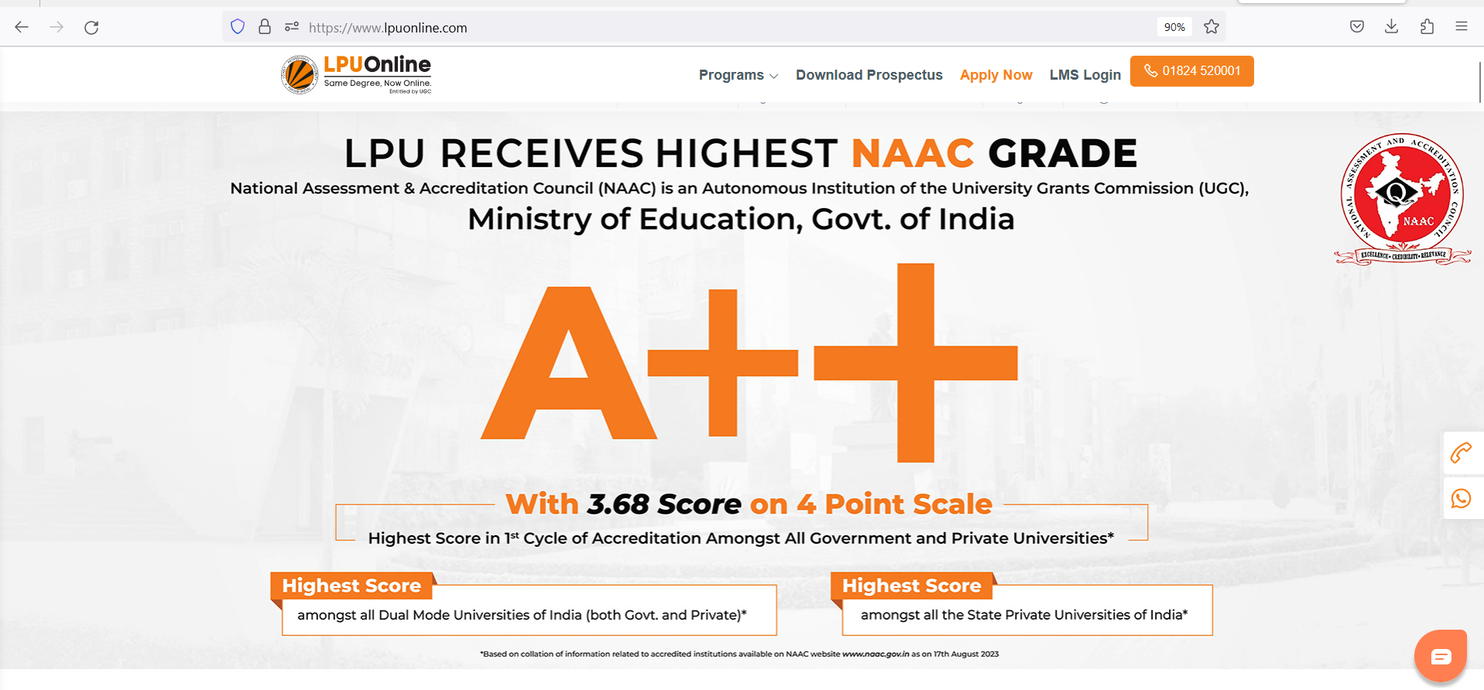
How to Log in
Direct URL:
https://lms.lpuonline.com/
Through website:
https://www.lpuonline.com/

Slide 7
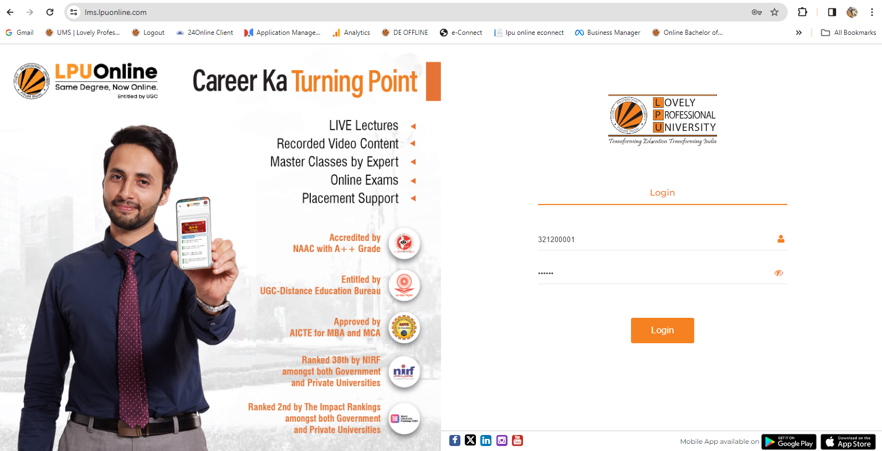
Log in to LPU e-Connect
Log in Using: User Name and Password provided by University
Username: “Registration No.”
“Credentials to be shared by University with all; subject to fulfilment of eligibility criteria and completion of admission process.”
How to Login

Slide 8
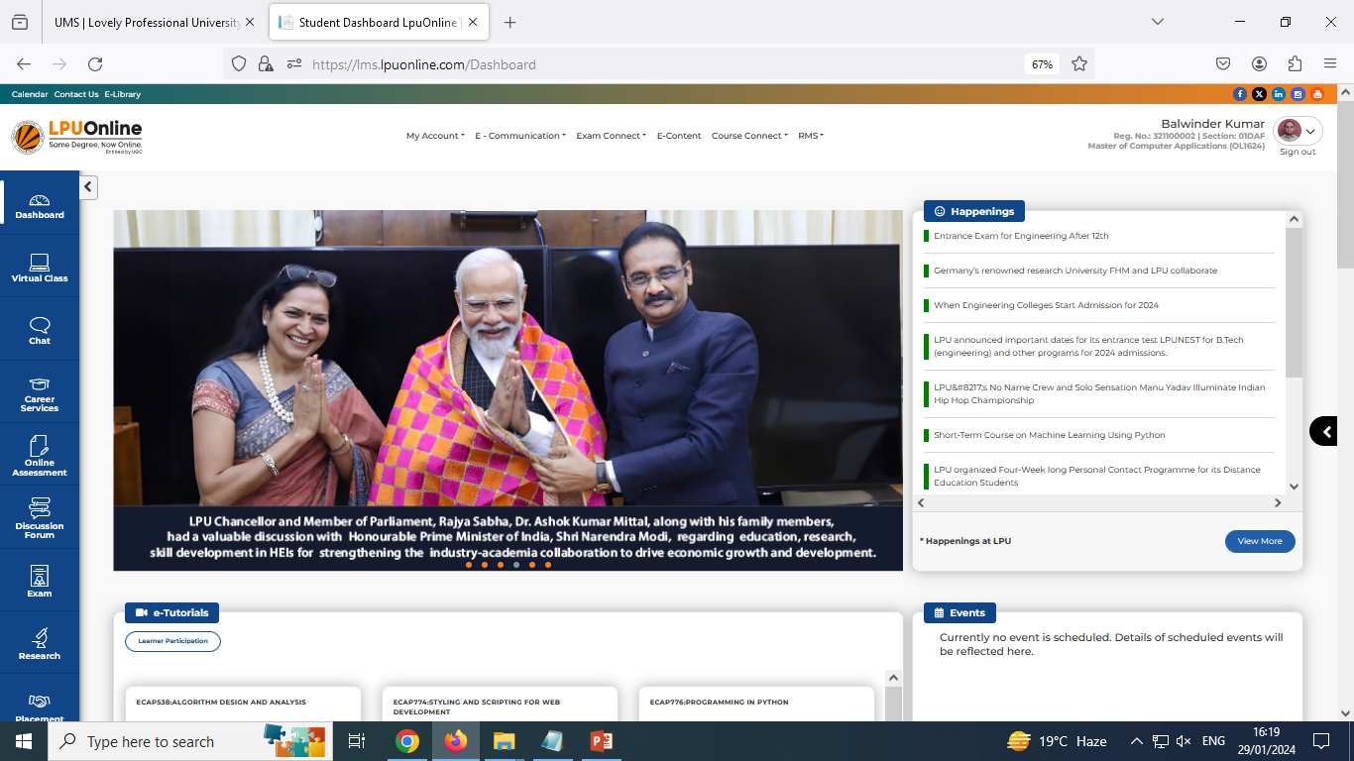
Dashboard with quick Links
Dashboard (After Login)
Path: LPU e-Connect Login --- > Dashboard

Slide 9
Dashboard with quick Links
Left Side Quick Links:
Virtual Class
Chat (LPU Live)
Online Assessment
Discussion Forum
Exam
Research
Placement
Middle Section:
Happenings
E-Tutorials
Learner Participation
Events
Today's Virtual Classes(Time Table, Attendance)
Assignments
My Messages
Calendar
Announcements

Slide 10
Virtual Class (Virtual Lab) Chat (LPU Live) Online Assessment Discussion Forum Exam Research Placement
Left Side Quick Links:

Slide 11
Left Side: Virtual Class
Link to access virtual class (Live class)
Virtual Class(Live Class)
Navigation: Dashboard>> Virtual Class
Or
Direct Link: https://myclass.lpu.in/
(Log in with same username and password of LPU e-Connect)
Schedule of classes to be shared on LMS under “Today’s Virtual Classes” section of Dashboard.

Slide 12
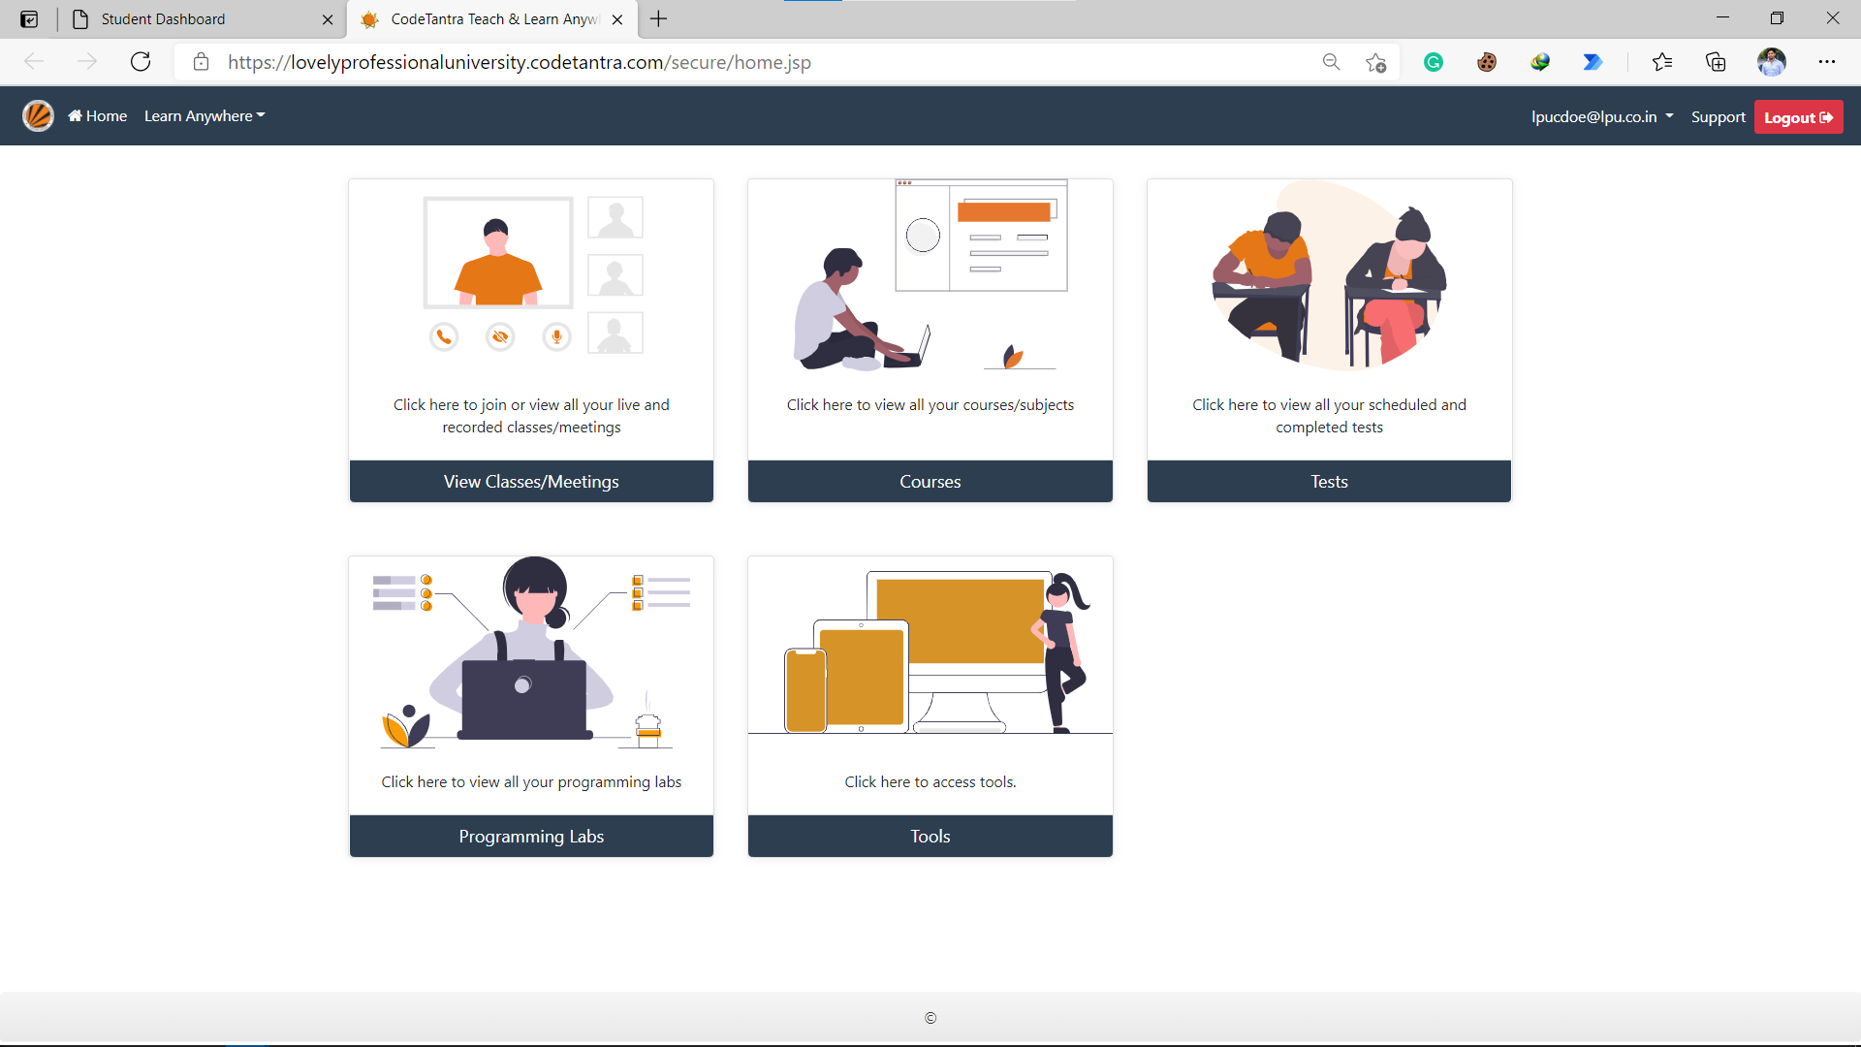
Virtual Class
Click to attend Virtual Class (Live Class)

Slide 13
Chat (LPU Live)
Navigation: Dashboard>> Chat
Or
Direct Link: https://lpulive.lpu.in/
(Log in with same username and password of LPU e-Connect)
Student can interact with fellow students and with faculty on the basis of allotted sections. The Platform allows users to share all type of files (pdf, images, audio, video etc).
Note: Platform to be used for academic interactions only.
Left Side: Chat (LPU Live)
Link to access LPU Live chat

Slide 14
Left Side: Online Assessment
Online Assessment
Navigation: Dashboard>> Online Assessment
Or
Direct Link: https://oas.lpu.in
(Log in with same username and password of LPU e-Connect)
Online Assessment System (OAS): An Online platform to conduct various kind online tests using specially designed question pool incorporated automated designing of test with auto calculation of result (other than unit wise self assessments given under e-Tutorial)
Link to Online Assessment

Slide 15
Left Side: Discussion Forum
Discussion Forum
Navigation: Dashboard>> Discussion Forum
To help students in addressing their course wise doubts related to the curriculum and to engage student in discussion of various topics with faculty and with fellow students.
Continuously monitored and managed by course faculty.
Post to be displayed after approvals only
Link to Course wise Discussion Forum

Slide 16
Left Side: Exam
Exam: Technology Enabled Proctored Examination
Navigation: Dashboard>> Exam
online platform to conduct technology enabled proctored examination/ test.
Link to Online Proctored Examination

Slide 17
Placement Assistance
Click to yes to fill details
Interested students can register for placement assistance by sharing their interest areas.
Announcement section to be checked on regular basis for quick updates related to placement assistance.
Click to Proceed
Click to Register

Slide 18
Happenings E-Tutorials Learner Participation Events Today's Virtual Classes(Time Table, Attendance) Assignments My Messages Calendar Announcements
Middle Section:

Slide 19
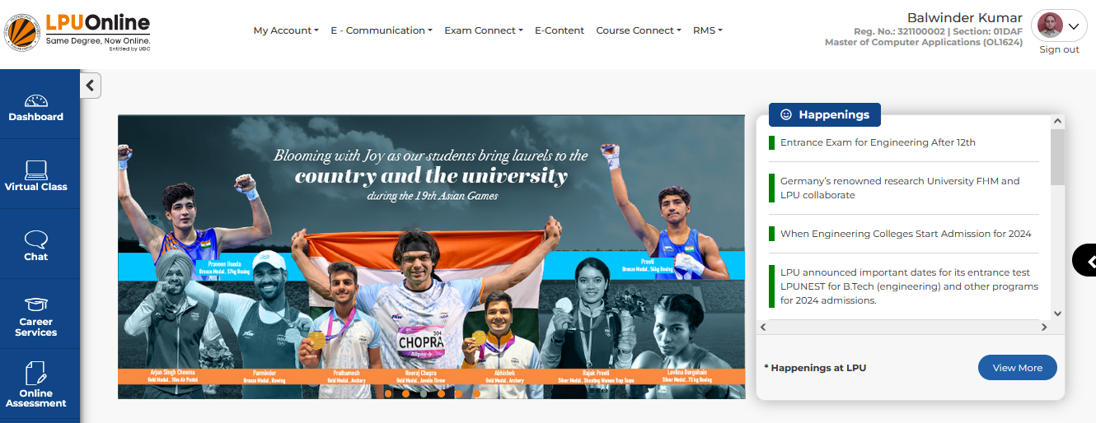
Happenings
Clicking on “View More” button to access “happenings.lpu.in”
Slides/ Carousel reflecting latest events

Slide 20
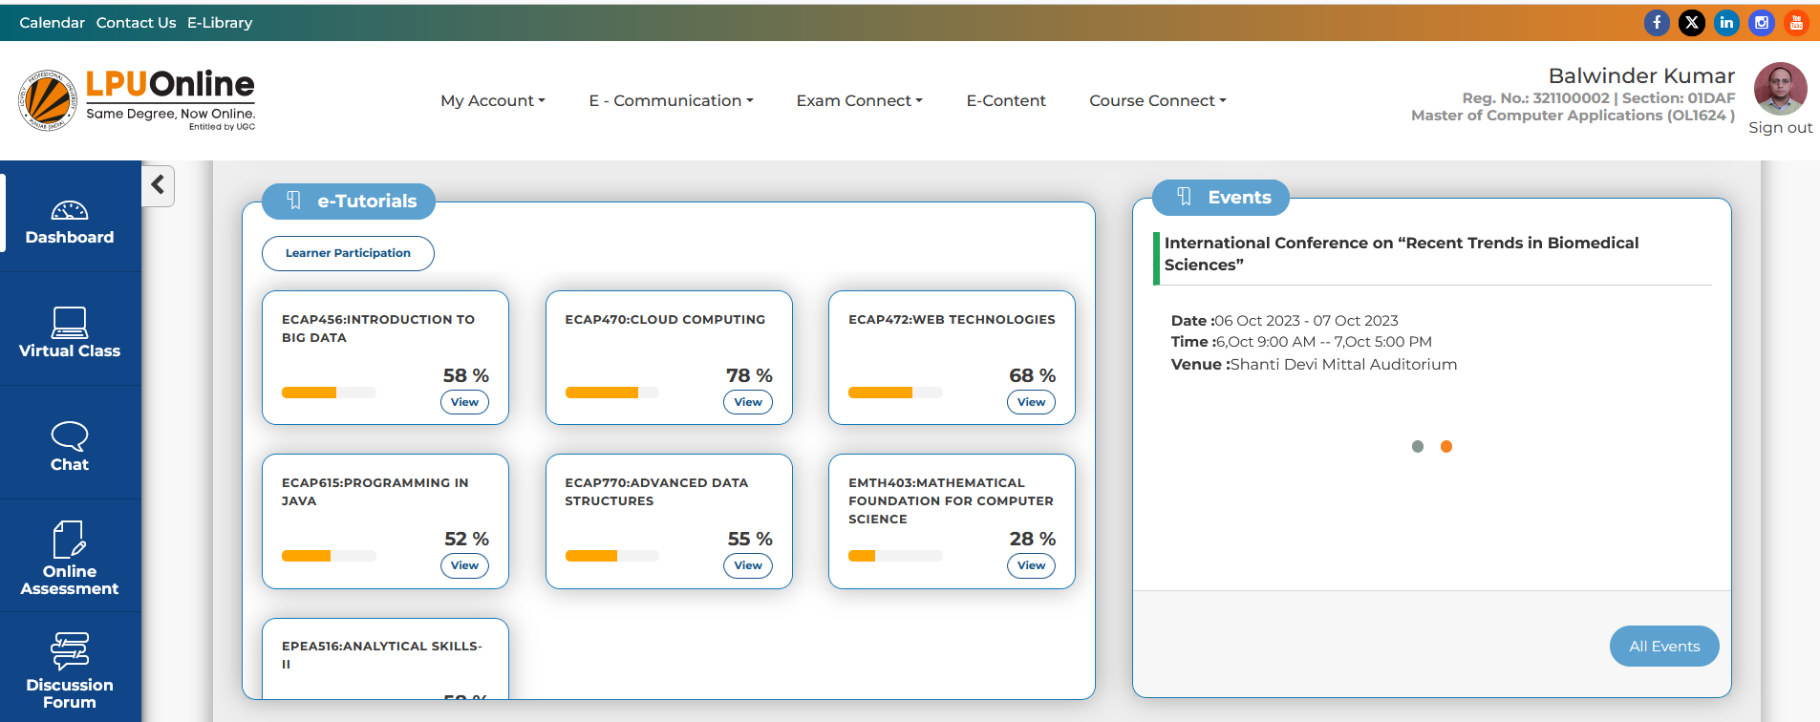
e-Tutorials
Let’s Select 1 Course
Navigation: Dashboard>> e-Tutorials
e-Tutorials: quick link to current term’s pre-recorded video
Providing access to following:
Course wise Pre-recorded videos further divided into Units
Unit wise self assessments (No restrictions, any unit can be accessed)
Overview, Transcripts, e-Resources, e-Notes etc.

Slide 21
e-Tutorials
Unit wise Course Content with progress bar
Video Lectures by University Faculty
Units categorized in the following three categories:
1. Previous Units (Already watched) 2. In Play (Currently watching) 3. Up Next (To be viewed)

Slide 22
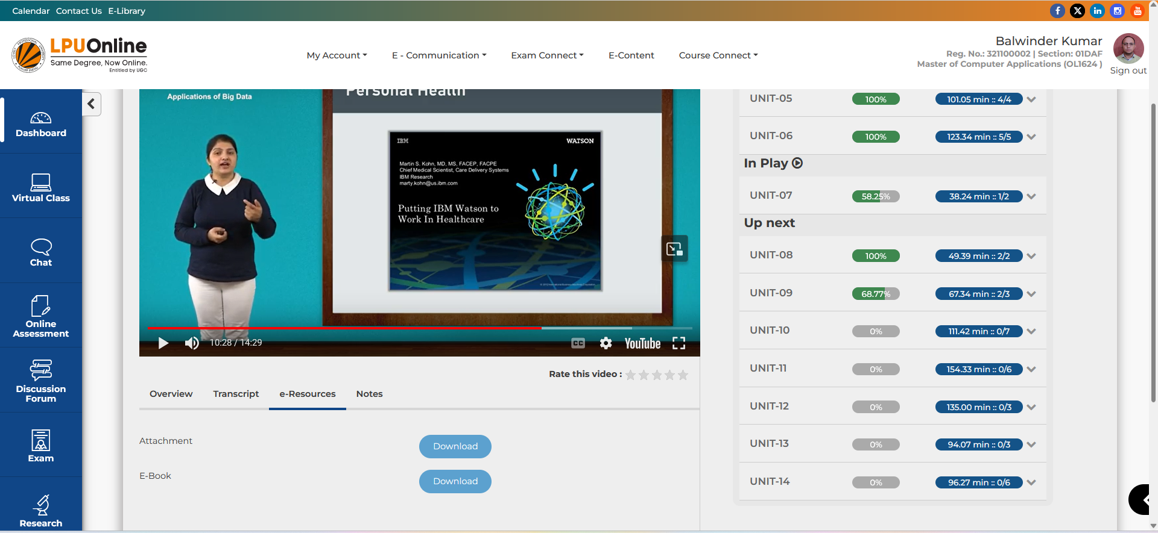
e-Tutorials
Overview of the Lecture
Lecture wise Transcripts in PDF format
PPTs used by Faculty in Video Lecture
e-Book of the Course
Make e-Notes while studying online

Slide 23
Learner’s Participation
Navigation: Dashboard>> Learner’s Participation
Learner’s Participation: real-time calculation of all components of academic participation and course wise display of all activities along with auto calculations to make the user aware of his/ her progress.
Academic Participation: 10%
Attendance of Live lectures (Virtual Classes)
Studying through Pre Recorded Videos
Quiz after every unit (Self Assessments)
Discussion Forum (No. of Approved posts/ replies in discussion forum)

Slide 24
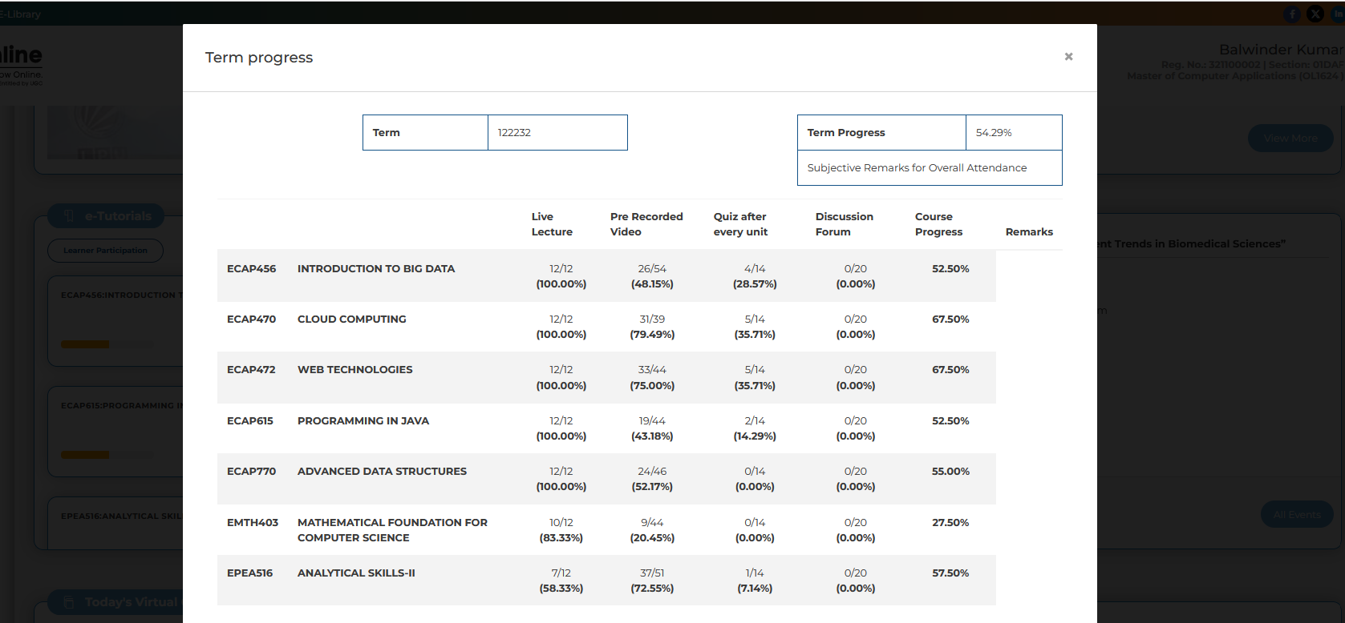
Learner’s Participation
Important Note: In order to be eligible to appear in End Term Exam of a particular course, the learners must have minimum score of 75% in the all course specific activities related to Academic Participation and Engagement.
Learners needs to be active on LMS for participating in various academic activities (at least for two hours every fortnight)

Slide 25
Today’s Virtual Class
Navigation: Dashboard>> Today’s Virtual Classes
It provides information regarding classes scheduled for the day and also this option reflects the Time Table or Live Classes schedule for upcoming days.
%age of Overall attendance in Live lectures
Attendance of Live classes to be updated with in 42 hours

Slide 26
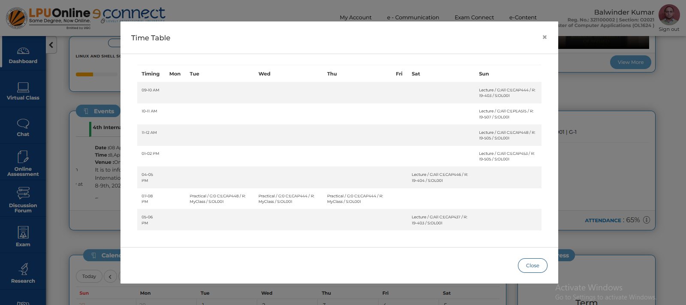
Today’s Virtual Class
Navigation: Dashboard>> Today’s Virtual Classes >> View Time Table
Weekly timetable on a click is available

Slide 27
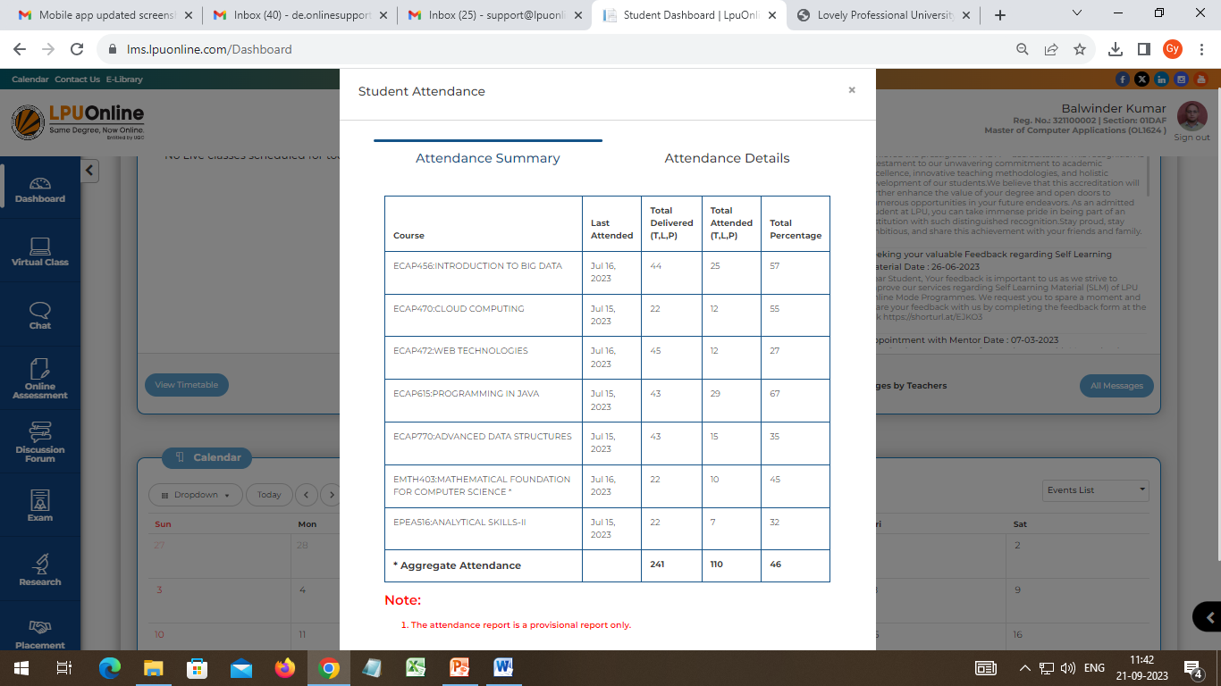
Attendance
Navigation: Dashboard>> Today’s Virtual Classes >> Attendance
Course wise attendance on a click is available

Slide 28
Assignments
Navigation: Dashboard>> Assignments
This section includes course wise assignments; provision to download and solved upload assignments.
To be available as per dates mentioned in Academic Calendar

Slide 29
My Messages
Navigation: Dashboard>> My Messages
History: Dashboard >> e-Communication >> Messages
To facilitate the user to view personalized messages posted by university related to Academics, Examinations and other

Slide 30
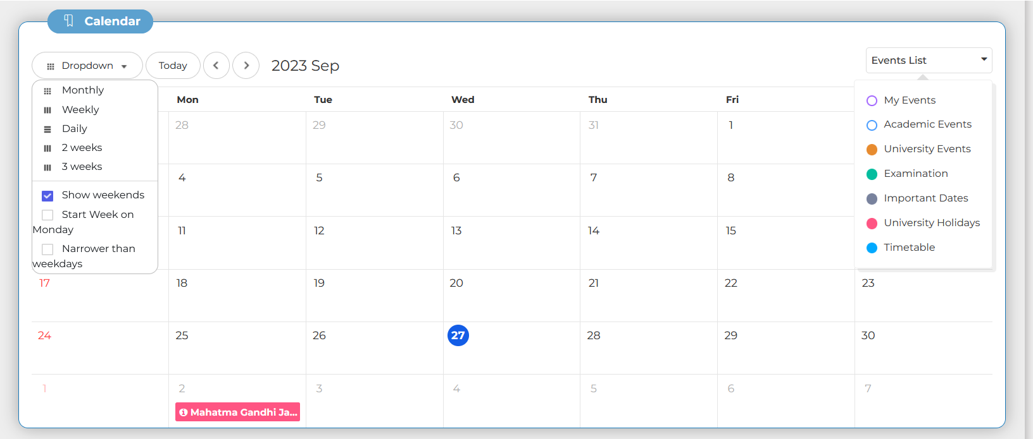
Calendar
Select the type of event to be highlighted on the Calendar
Navigation: Dashboard>> Calendar
Provision for learner to schedule the activities. Also provides information related to upcoming events Day Wise, Weekly or Month wise.
Quick view of time table, list of holidays and important upcoming event on Calendar.

Slide 31
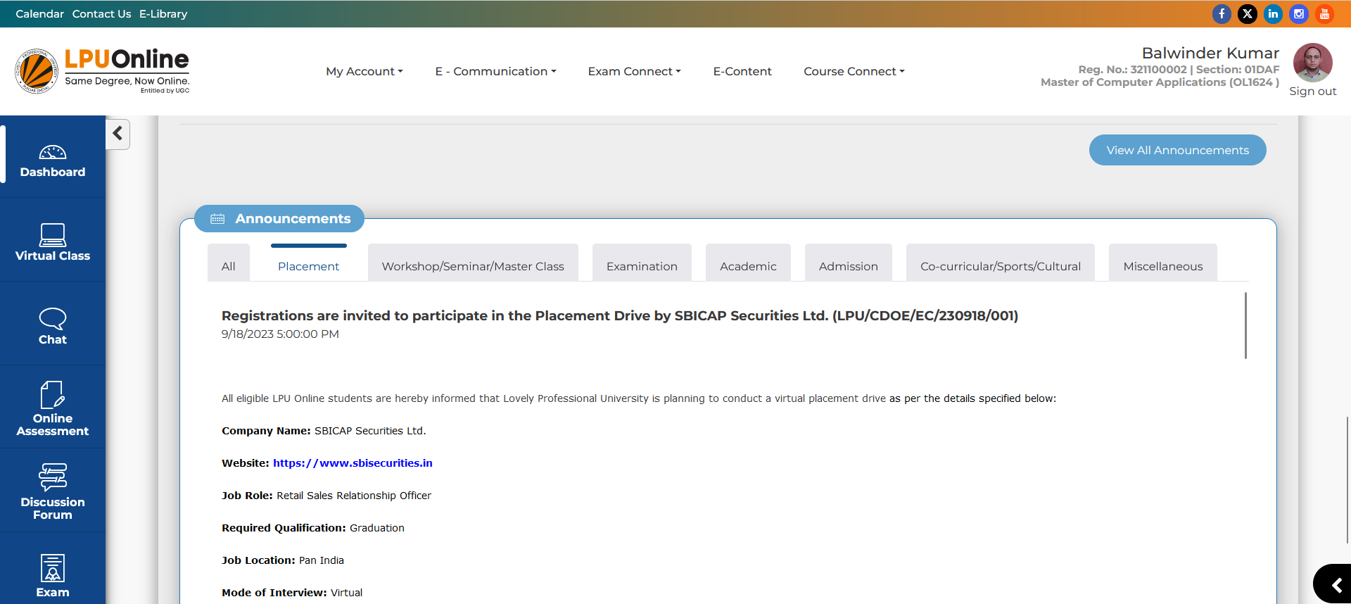
Announcements
Provision to see category wise Announcements

Slide 32
Main Menu

Slide 33
LPU e-Connect: Main Menu
Menu: Menu available on Dashboard provides easy access to various interfaces
Main Menu on Top:
Social Media Quick links
My Account
e-Communication
Exam Connect
E-Content
Course Connect
RMS
e-Library
Calendar
Contact Us
Quick Information
Student Photo
Registration No.
Programme
Help Manual
Provision to Change Password
My Profile

Slide 34
LPU e-Connect: My Account
My Account: "My Account" is a personalized account of the user containing maximum details related to the user and his account. User can view and edit his/ her profile.
ID Card
Online Fee Payment
My Profile
Edit Profile
My Fee Details
Fee Receipt

Slide 35
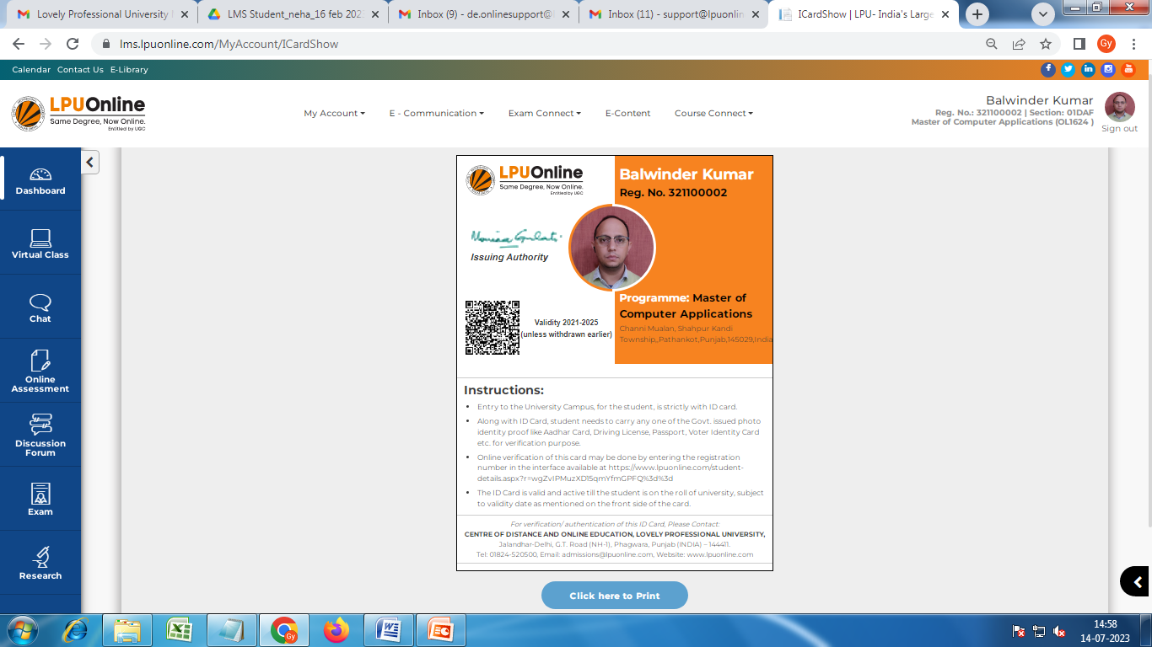
LPU e-Connect: My Account
a. ID Card
Navigation: Dashboard>> My Account >> ID card
Student can also print the ID card, Printing is limited to 3 attempts
Scan QR Code to verify the ID Card
Provision to print the ID Card

Slide 36
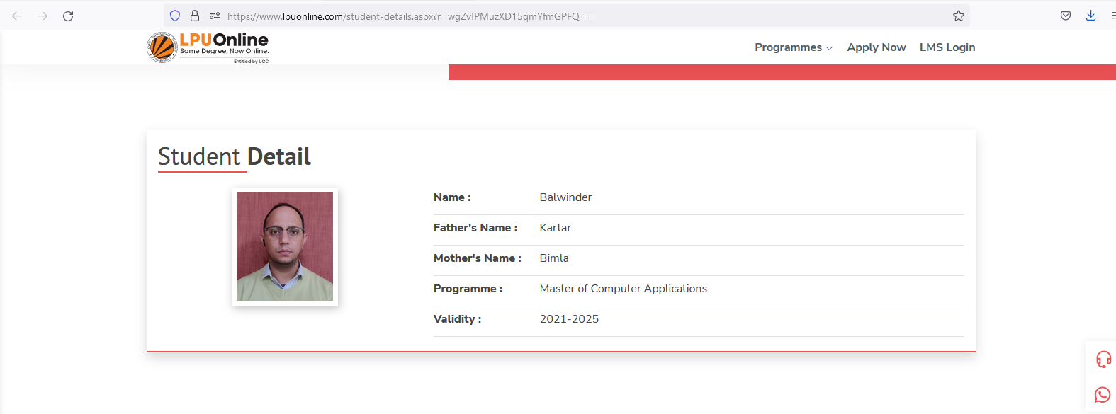
LPU e-Connect: My Account
a. ID Card Verification from website
Click on the verification Link given in the ID cards Instructions: https://cutt.ly/oUbzOIX
Or
Scan the QR code given on ID Card

Slide 37
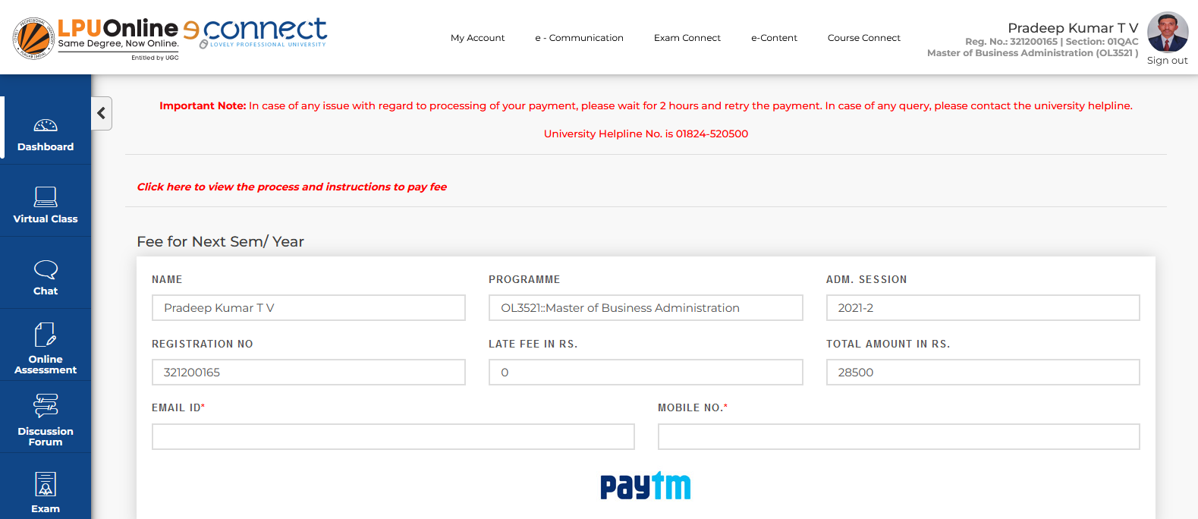
LPU e-Connect: My Account
b. Online Fee Payment
Navigation: Dashboard>> My Account >> Online Fee Payment
Online fee payment for next semester to get yourself registered; wait for 2 hours to reattempt if status not updated to avoid double payments
All details are auto filled
Fill email ID and Phone No.
Click to pay fee

Slide 38
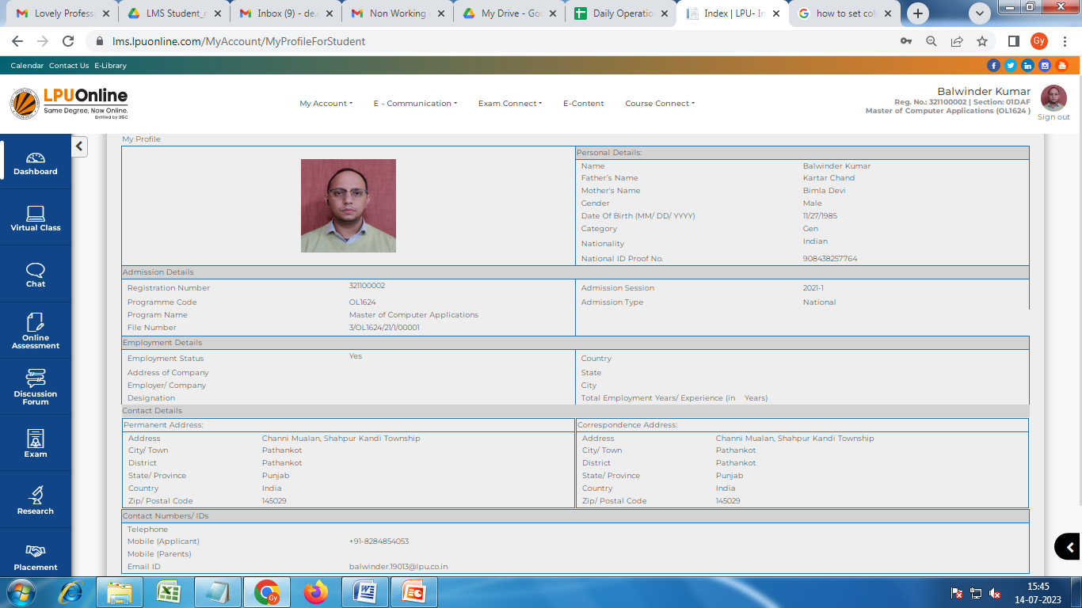
LPU e-Connect: My Account
c. My Profile
Navigation: Dashboard>> My Account >> My Profile
Personalized account of student containing information related to his/her personal and academic details.

Slide 39
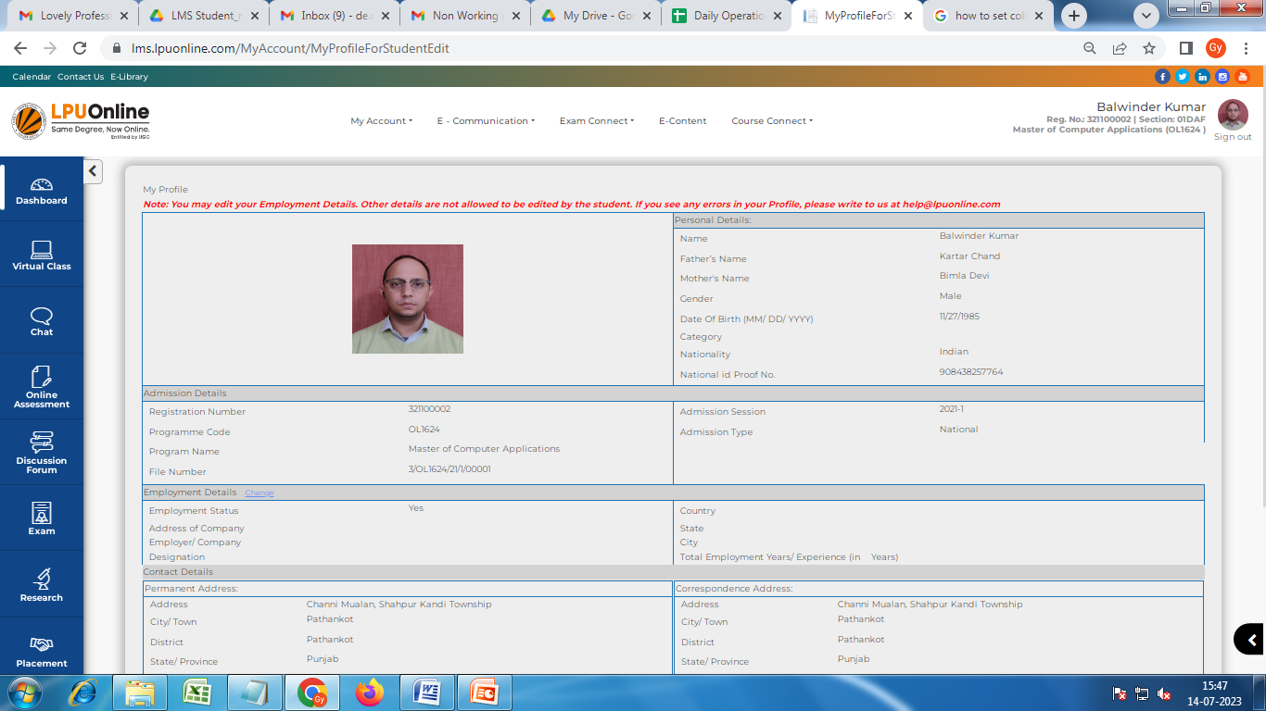
LPU e-Connect: My Account
d. Edit Profile
Navigation: Dashboard>> My Account >> Edit Profile
To provide the facility for updating some of personal and other details (Updated employment details)

Slide 40
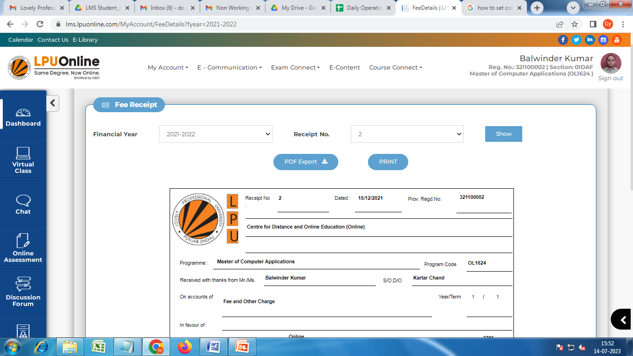
LPU e-Connect: My Account
e. My Fee Details
Navigation: Dashboard>> My Account >> My Fee Details>>Fee Receipt
View fee receipt once the fee is received by University and updated after verification
Select fee payment session
Select Receipt No.
Click on “Show” to view fee receipt
Click on “Print” to print fee receipt.

Slide 41
LPU e-Connect: e-Communication
e- Communication: To facilitate the user to view all announcements, personalized messages/ posted by university related to various day to day activities related to academics, examinations and other categories
Note: all communications by University will be done through LMS only
My Messages
e-Announcements

Slide 42
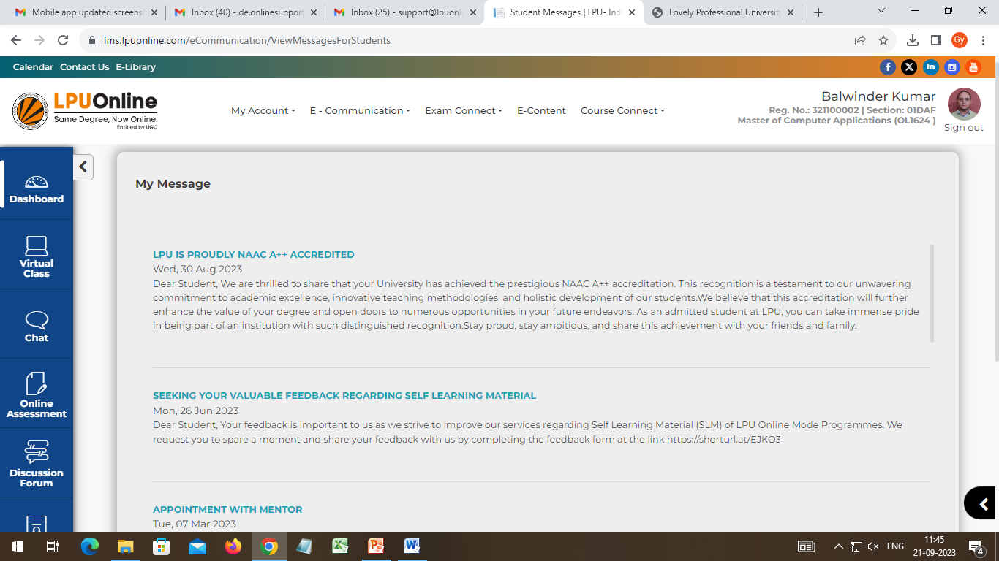
LPU e-Connect: e-Communication
a. My Messages
Navigation: Dashboard >> e-Communication >> My Messages
To facilitate the user to view personalized messages posted by university related to Academics, Examinations and other categories

Slide 43
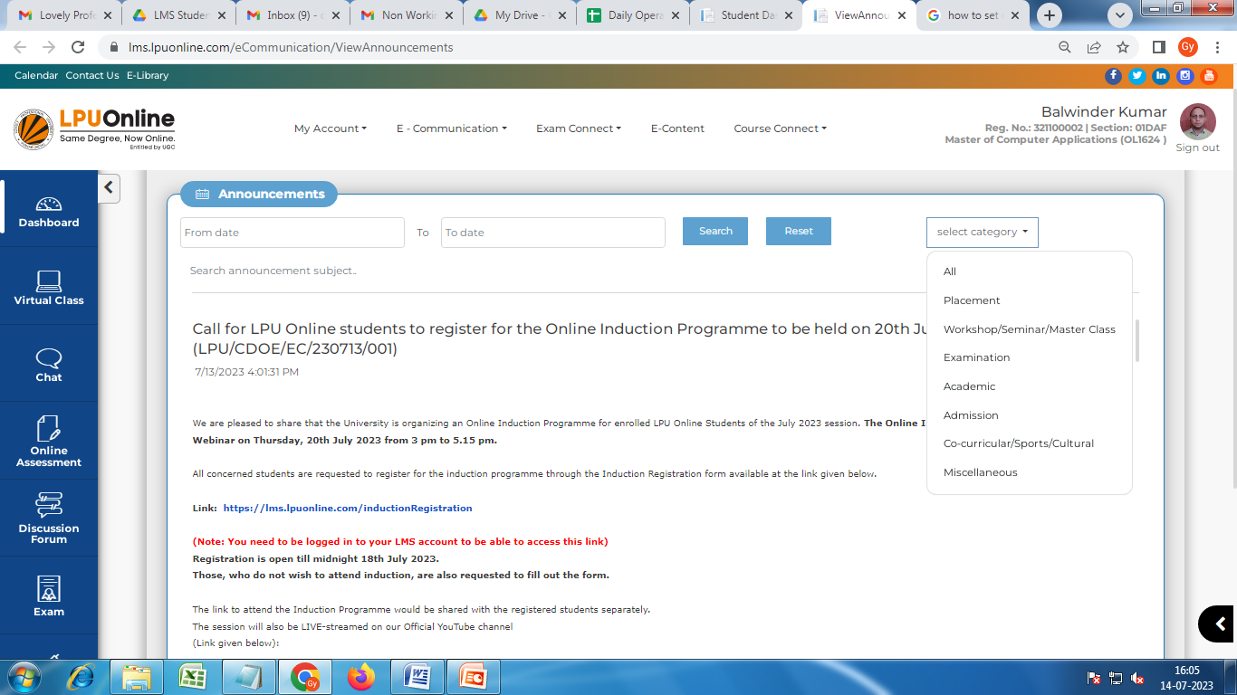
LPU e-Connect: e-Communication
b. e-Announcements
Navigation: Dashboard>> e-Communication >> Announcements
All announcements can be viewed under this section related to various categories, to keep student informed and connected with University
Date-wise Announcements search
Search Category wise announcements.

Slide 44
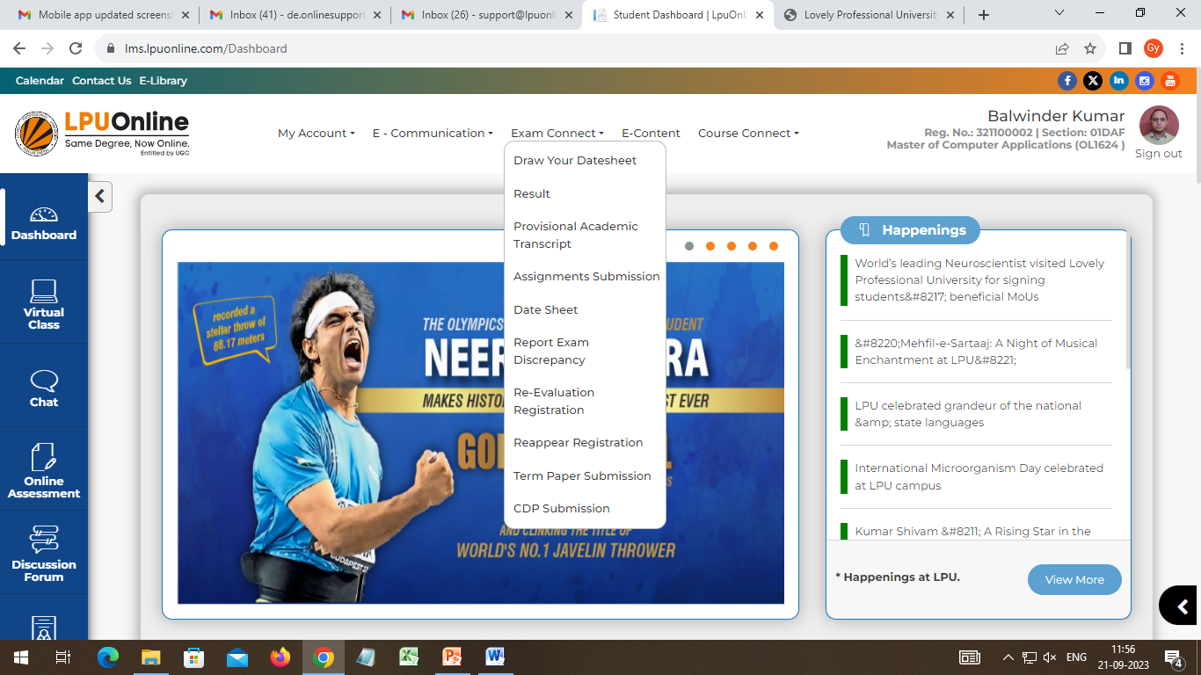
LPU e-Connect: Exam Connect
Exam Connect: To provide easy access to resources and information related to Examination and Result e.g. Date Sheet, Admit Card, Assignment Submission, Result, etc. (The interfaces to be visible and accessible on or before the applicable timelines of assignment submission and Examination)
Assignment Submission
Term Paper Submission
CDP Submission
d. Draw your Datesheet
Datesheet
Report Exam Discrepancy
Result
Re-evaluation Registration
Reappear Registration
Provisional Academic Transcript

Slide 45
LPU e-Connect: Exam Connect
a. Assignments Submission
Navigation: Dashboard >> Exam Connect >> Assignments Submission
Provision to download the assignments of all courses and to upload the hand written assignments in the form of Image by following the process prescribed by the university
Guidelines for uploading assignments through LMS
Guidelines for uploading assignments through Mobile App
Course Name and Course Code
No. of Assignments to be submitted
No. of assignments submitted by student

Slide 46
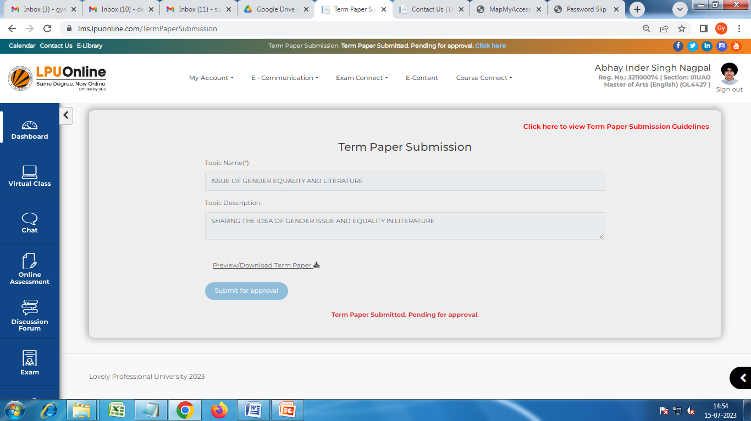
LPU e-Connect: Exam Connect
b. Term Paper Submission
Navigation: Dashboard >> Exam Connect >> Term Paper Submission
Provision to submit the Term Paper directly through the interface as applicable in programme scheme
Note: Term Paper Submission Interface will be open for applicable students only.
Enter Topic Namer & Description
Provision to download / preview
Click to download/view the guidelines on of Term Paper

Slide 47
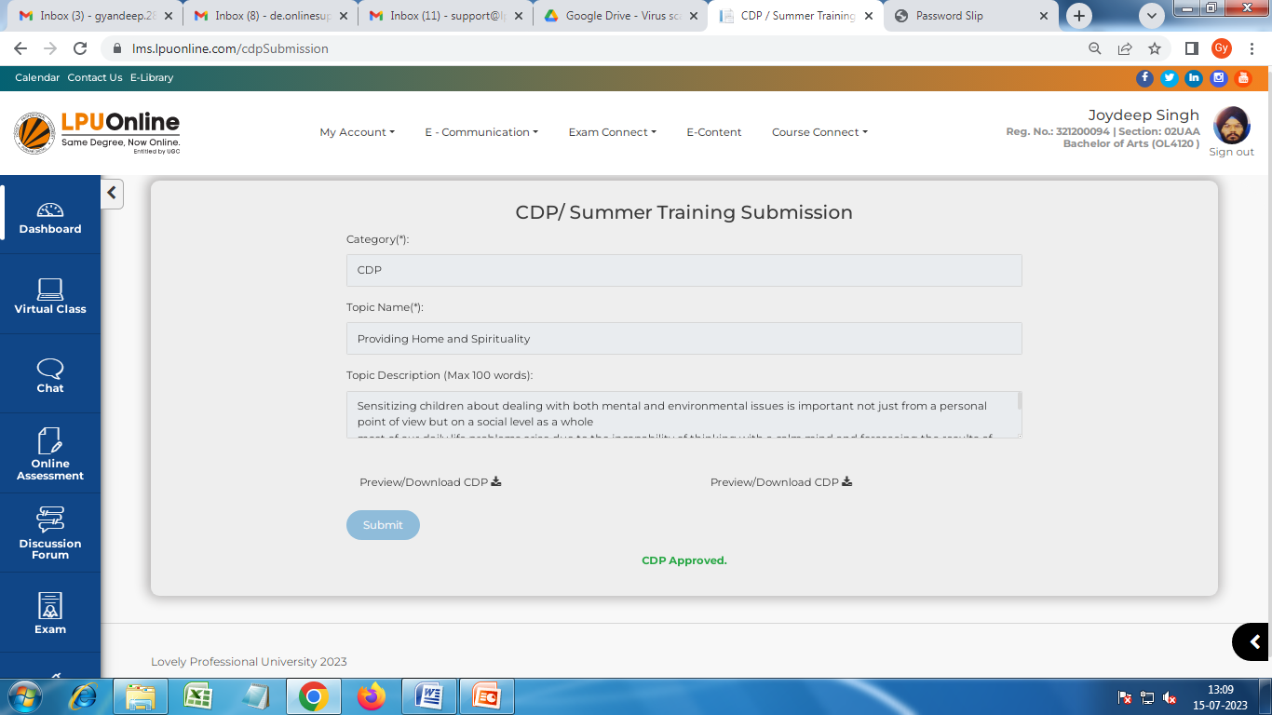
LPU e-Connect: Exam Connect
c. CDP Submission
Navigation: Dashboard >> Exam Connect >> CDP Submission
Provision to submit the CDP directly through the interface
Note: CDP Submission Interface will be open for applicable students only.
Select category as applicable
Enter Topic Name and description
Submit for Approval

Slide 48
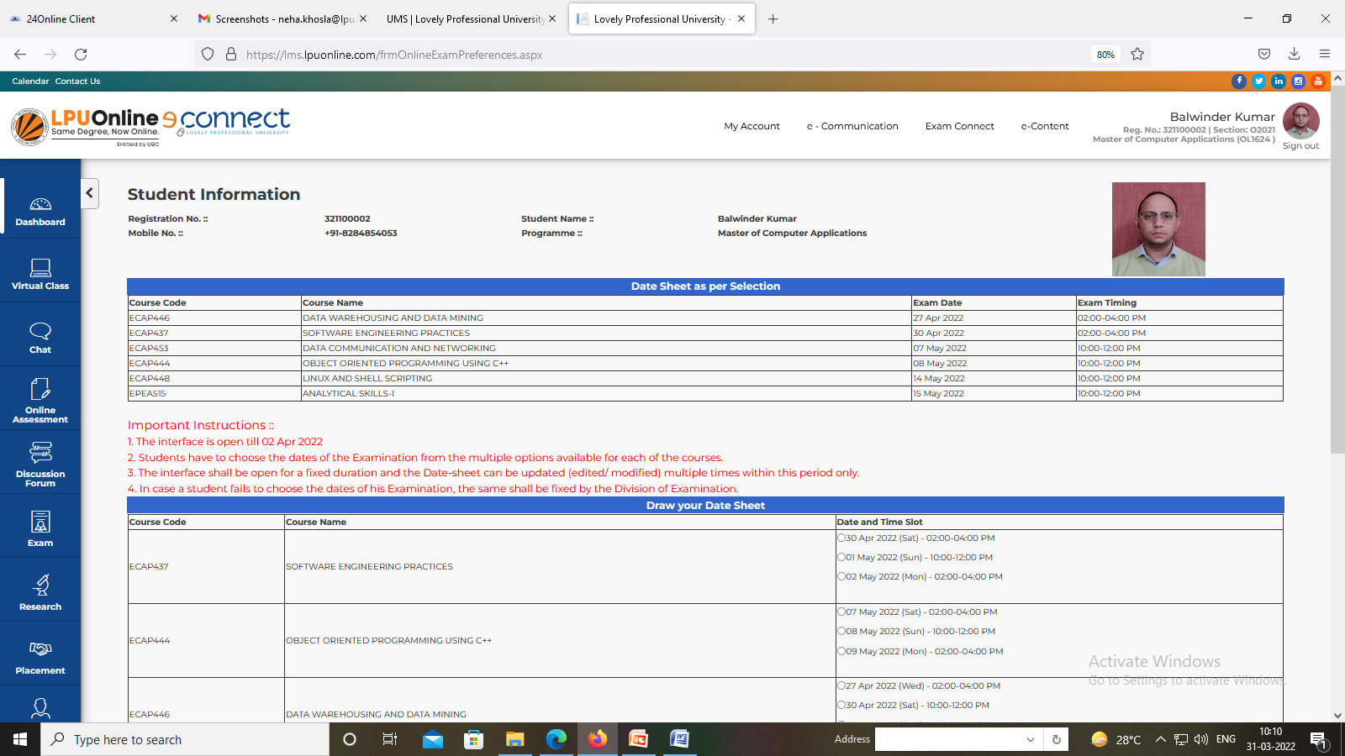
LPU e-Connect: Exam Connect
d. Draw your Datesheet
Navigation: Dashboard >> Exam Connect >> Draw your Datesheet
Providing flexibility and convenience to 'Draw your Date-sheet', it allows you to choose days/ dates/ time slot for your End term Examination.

Slide 49
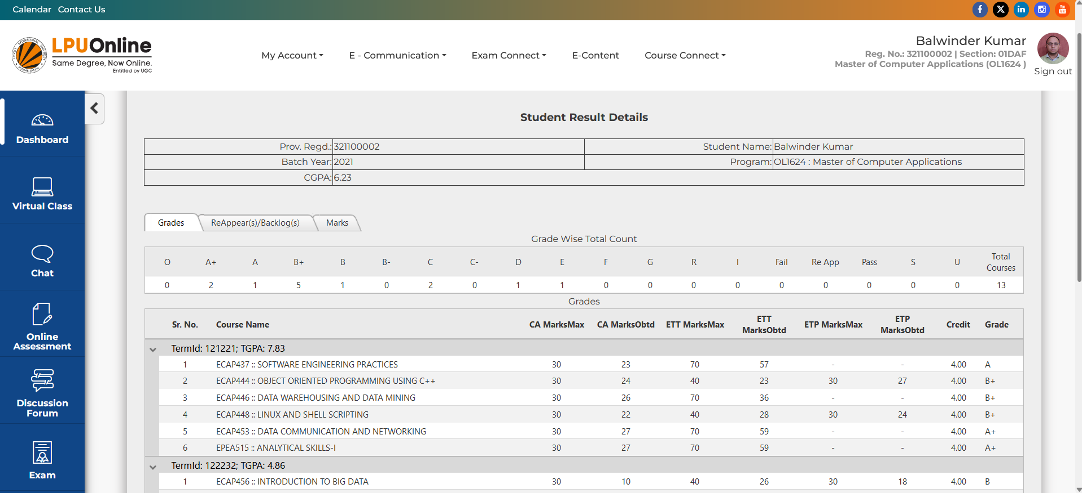
LPU e-Connect: Exam Connect
g. Result
Navigation: Dashboard >> Exam Connect >> Result
On a click availability of Marks/ Final Grades/ Result of Re-appears on or before applicable timelines

Slide 50
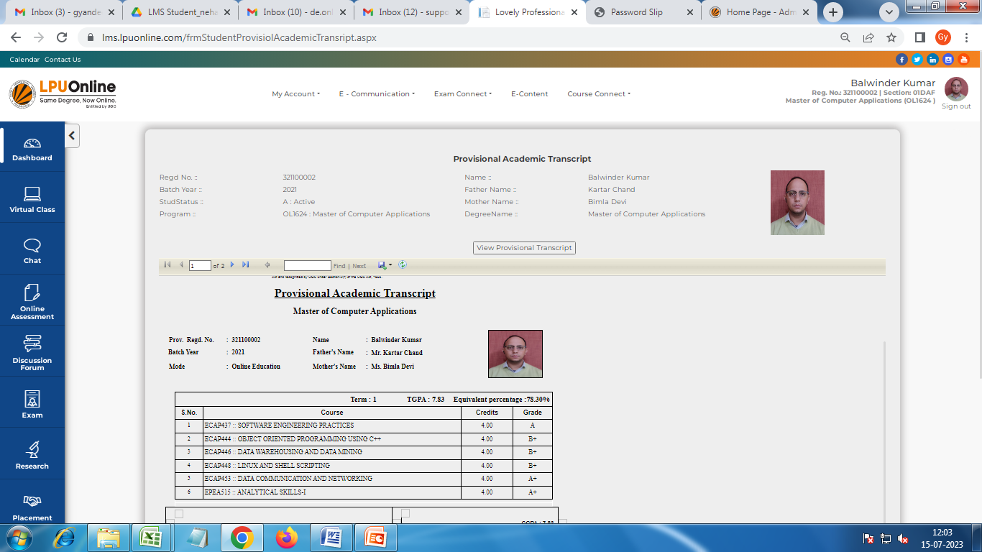
LPU e-Connect: Exam Connect
j. Provisional Academic Transcript
Navigation: Dashboard >> Exam Connect >> Provisional Academic Transcript
Click to view Transcript
Can be downloaded

Slide 51
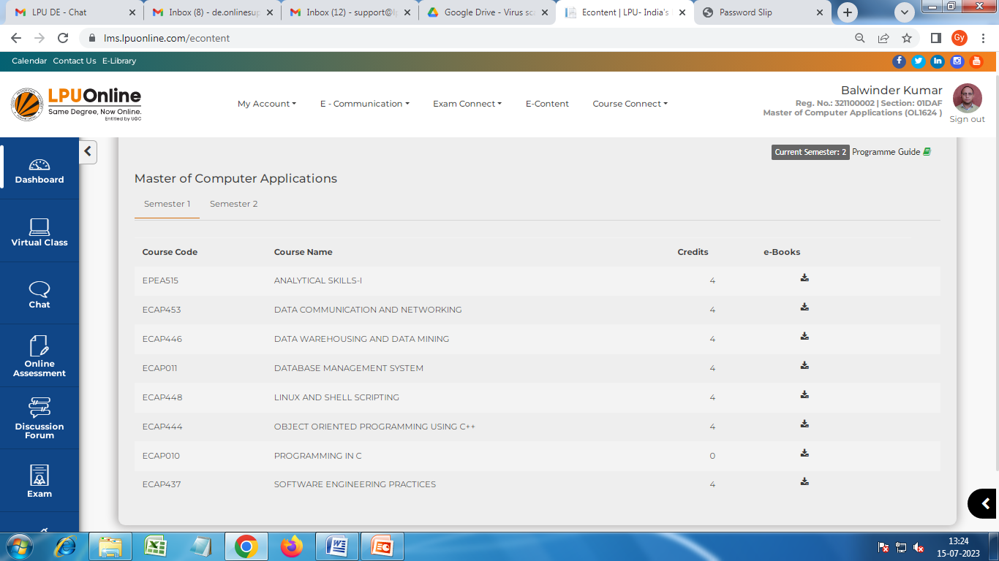
LPU e-Connect: e-Content
e-Content : providing access to e-books of registered courses and programme guide.
Navigation: Dashboard >> e-Content
Provision to access semester and course wise e-Books and availability of Programme Guide on a click.
Semester-wise e-Books
Click to download e-Book

Slide 52
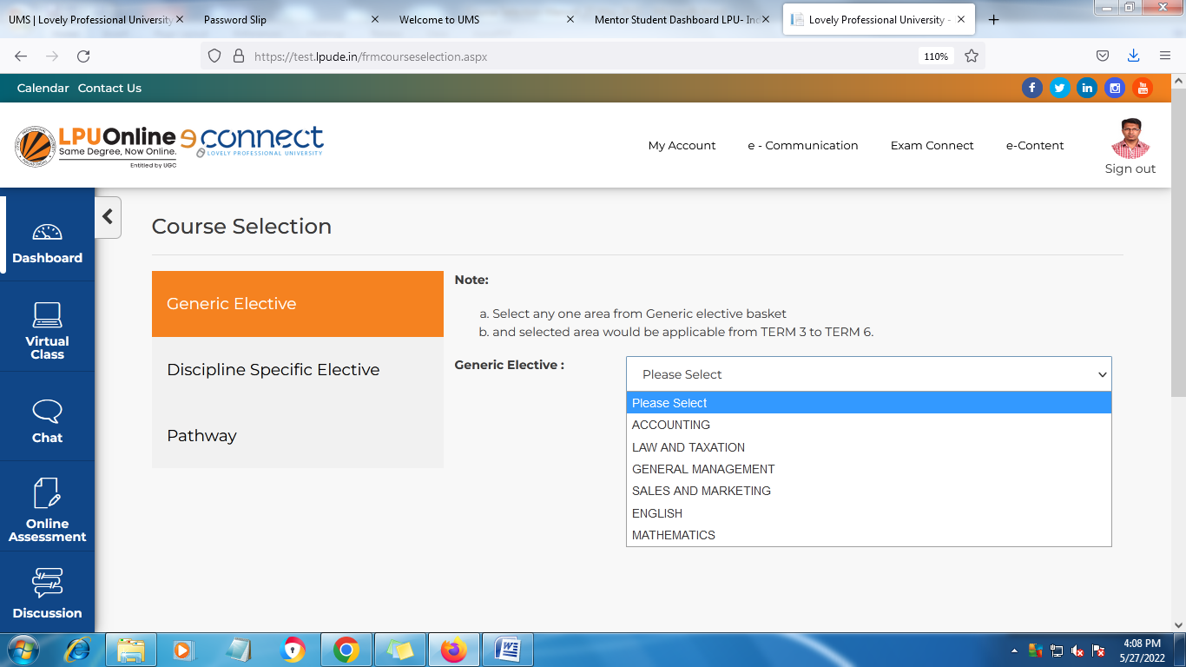
LPU e-Connect: Course Connect
a. Course Selection
Navigation: Dashboard >> Course Connect >> Course Selection
Select your courses as applicable to the programme scheme, all must submit the course selection on time
Instructions for Generic Elective Selection

Slide 53
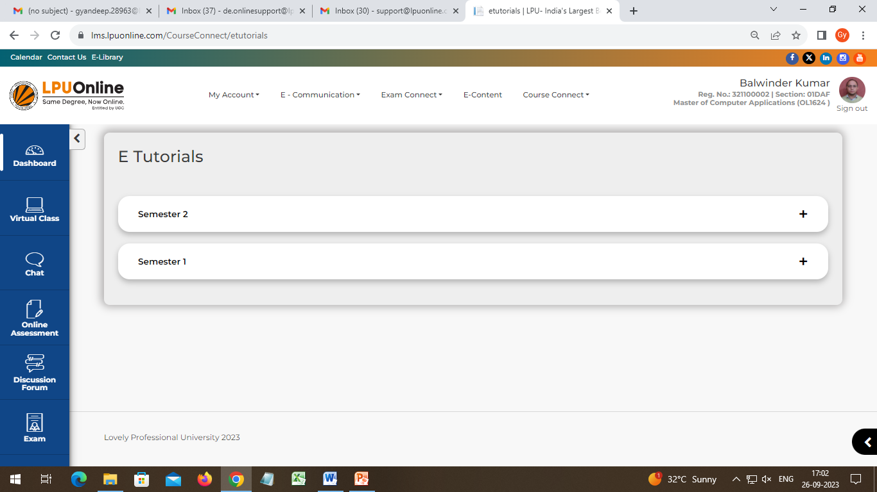
LPU e-Connect: Course Connect
b. My Courses
Navigation: Dashboard >> Course Connect >> My Courses
Provision to access semester-wise e-tutorials including video content of previous semesters.
Click here to view the registered courses of semester

Slide 54
LPU e-Connect: RMS
RMS: Provision for raising the request/query related to various categories as per available in the RMS Log Request interface and to view the history of previous RMS and their replies by the university
Log Request
History

Slide 55
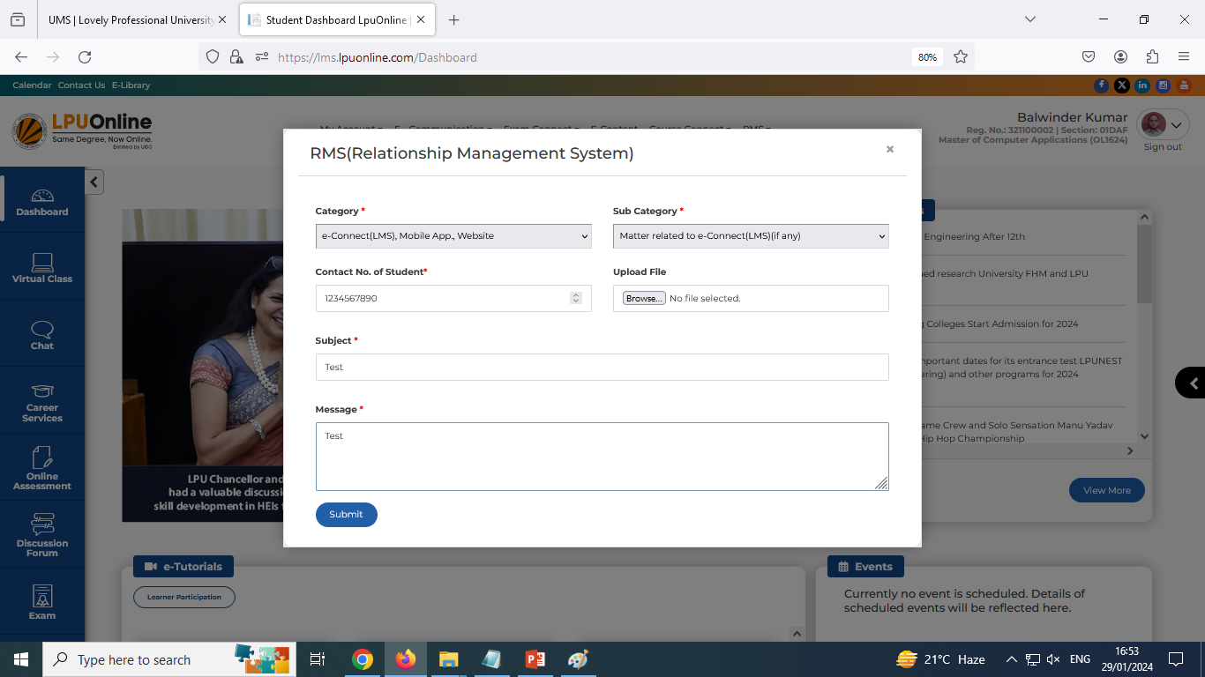
LPU e-Connect: RMS
a. Log Request
Navigation: Dashboard >> RMS >> Log Request
Provision to log new RMS request by selecting appropriate option from the available categories and by clicking on “Submit”:
Select Sub category
Select category from the dropdown
Upload file (if available)

Slide 56
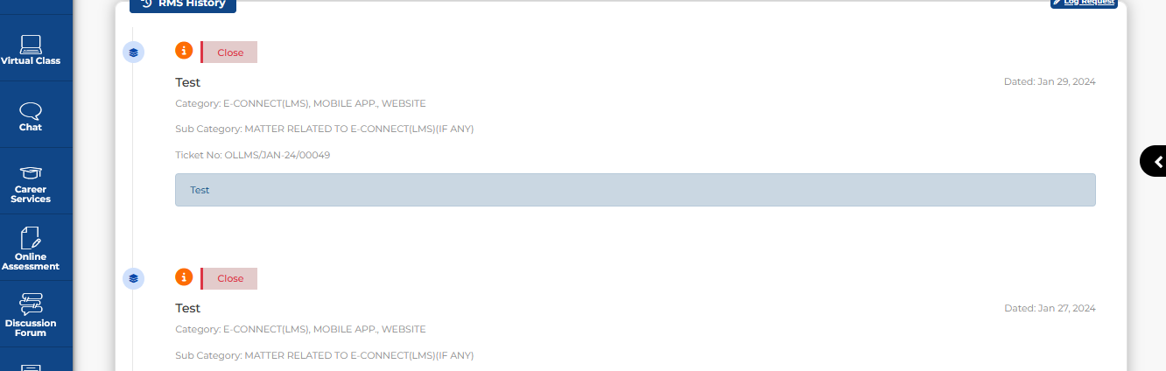
LPU e-Connect: RMS
b. History
Navigation: Dashboard >> RMS >> History
Provision to view the history of all the submitted RMS requests and to view the replies by the university:
Click here to view the reply by the university

Slide 57
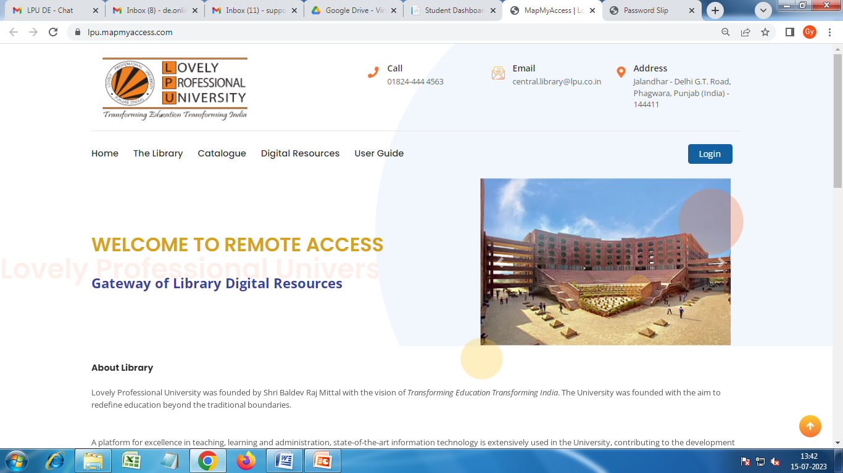
LPU e-Connect: e-Library
e-Library: Online Access is provided to users for variety of e-resources through e-Library. The remote access to add on e-resources is given to all users and students can access the e-Library with same credentials provided by University for accessing the LMS.
Step-1
Click to go to Log in window

Slide 58
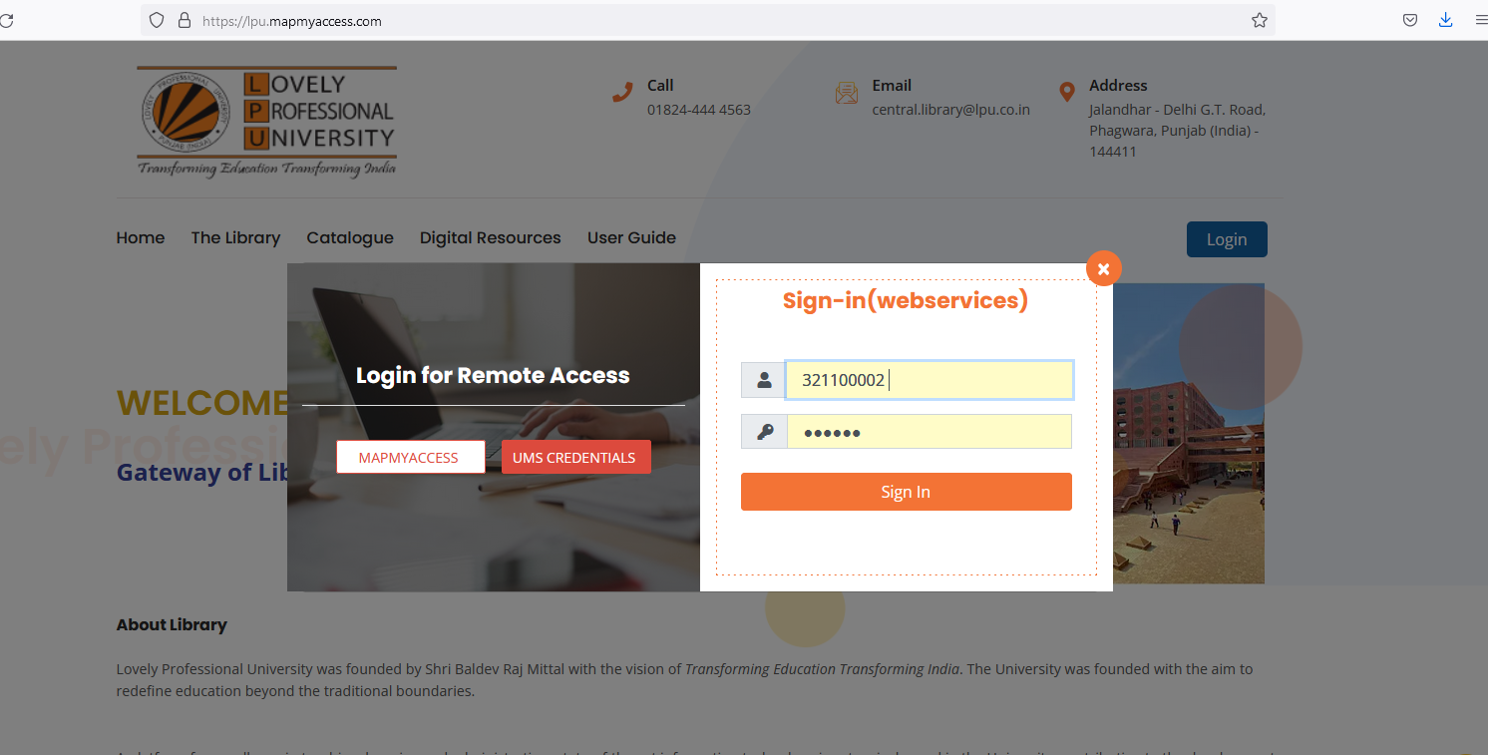
LPU e-Connect: e-Library
Step-2
Step-3
Click here to view “Sign-in(webservices) box
Log in with credentials provided by University (Same credentials of LMS)

Slide 59
LPU e-Connect: Calendar
Navigation: Dashboard >> Calendar
Important Dates
List of Holidays
Click here to download

Slide 60
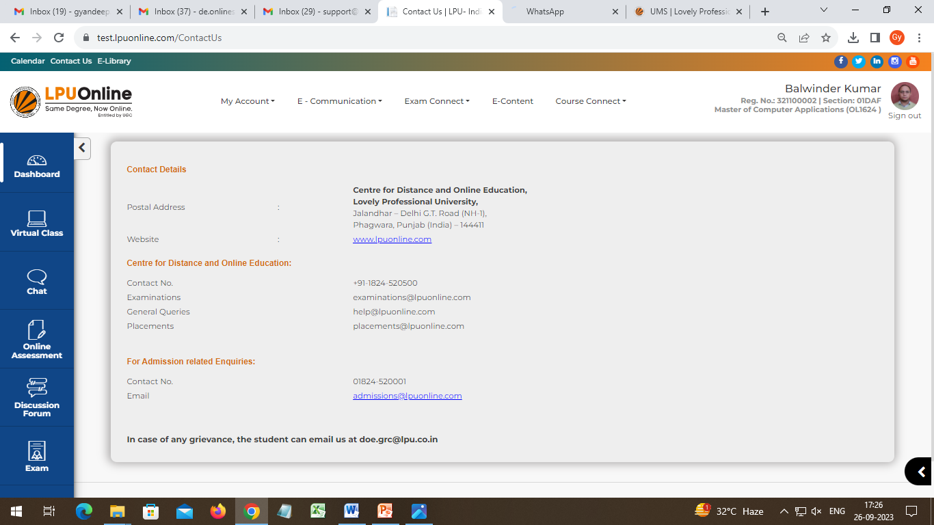
LPU e-Connect: Contact Us
Navigation: Dashboard >> Contact Us
Contact Us: Quick access to the important contact detail

Slide 61
Mobile App-LPU Online Play store: Android Apple Store: IOS

Slide 62
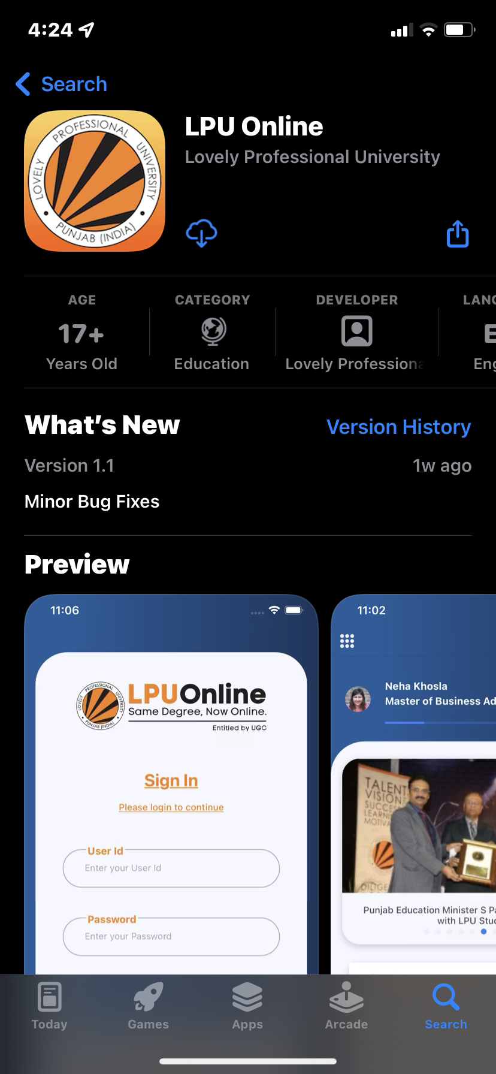
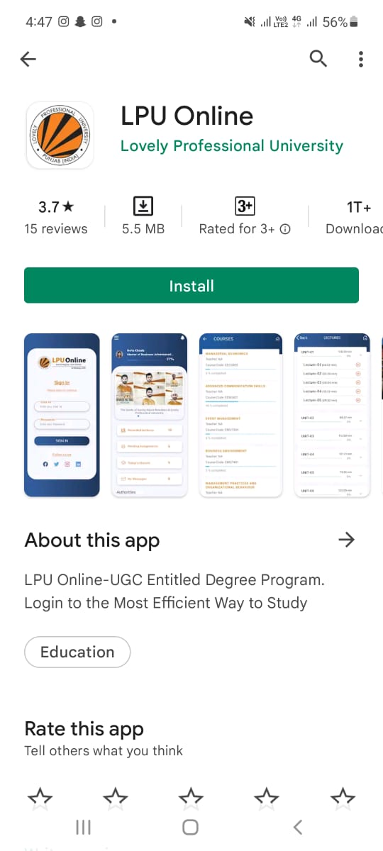
LPU e-Connect: LPU Online Mobile App
Android user to download app from pay store and IOS users to download app from Apple store by searching “LPU Online”
iPhone
Android

Slide 63
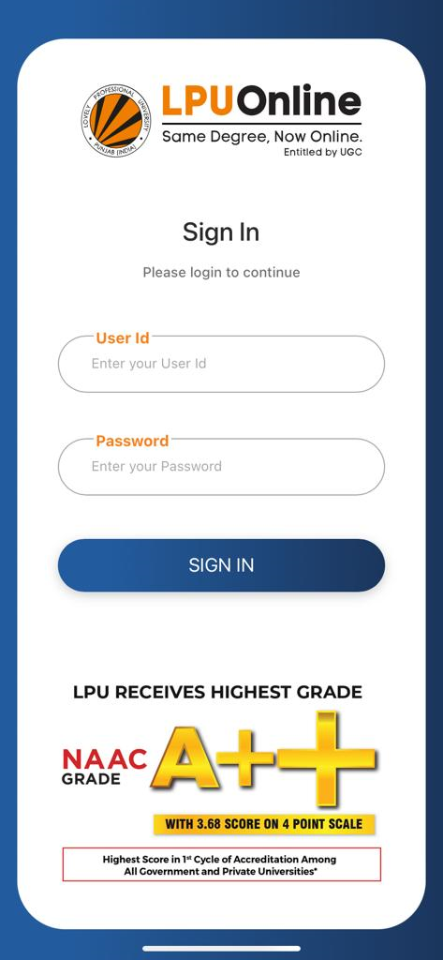
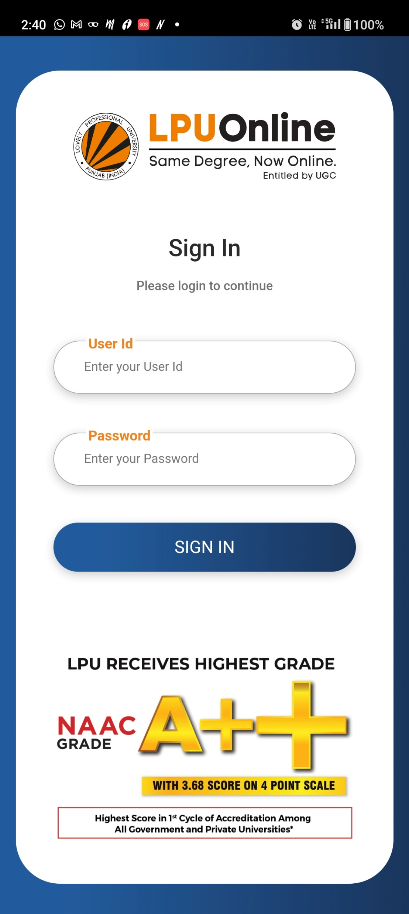
LPU e-Connect: Mobile App
The app is available and can be accessed by registered students by using username & password of LPU e-Connect (LMS).
iPhone
Android

Slide 64
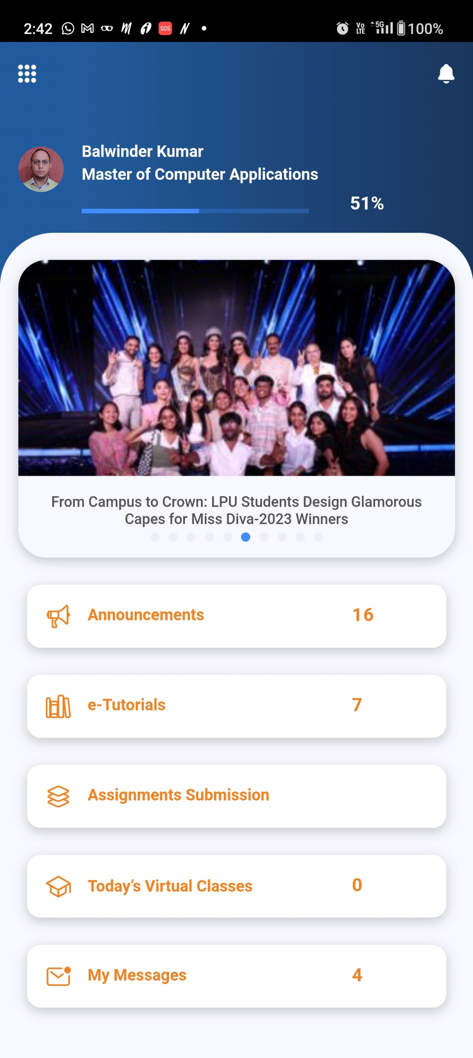
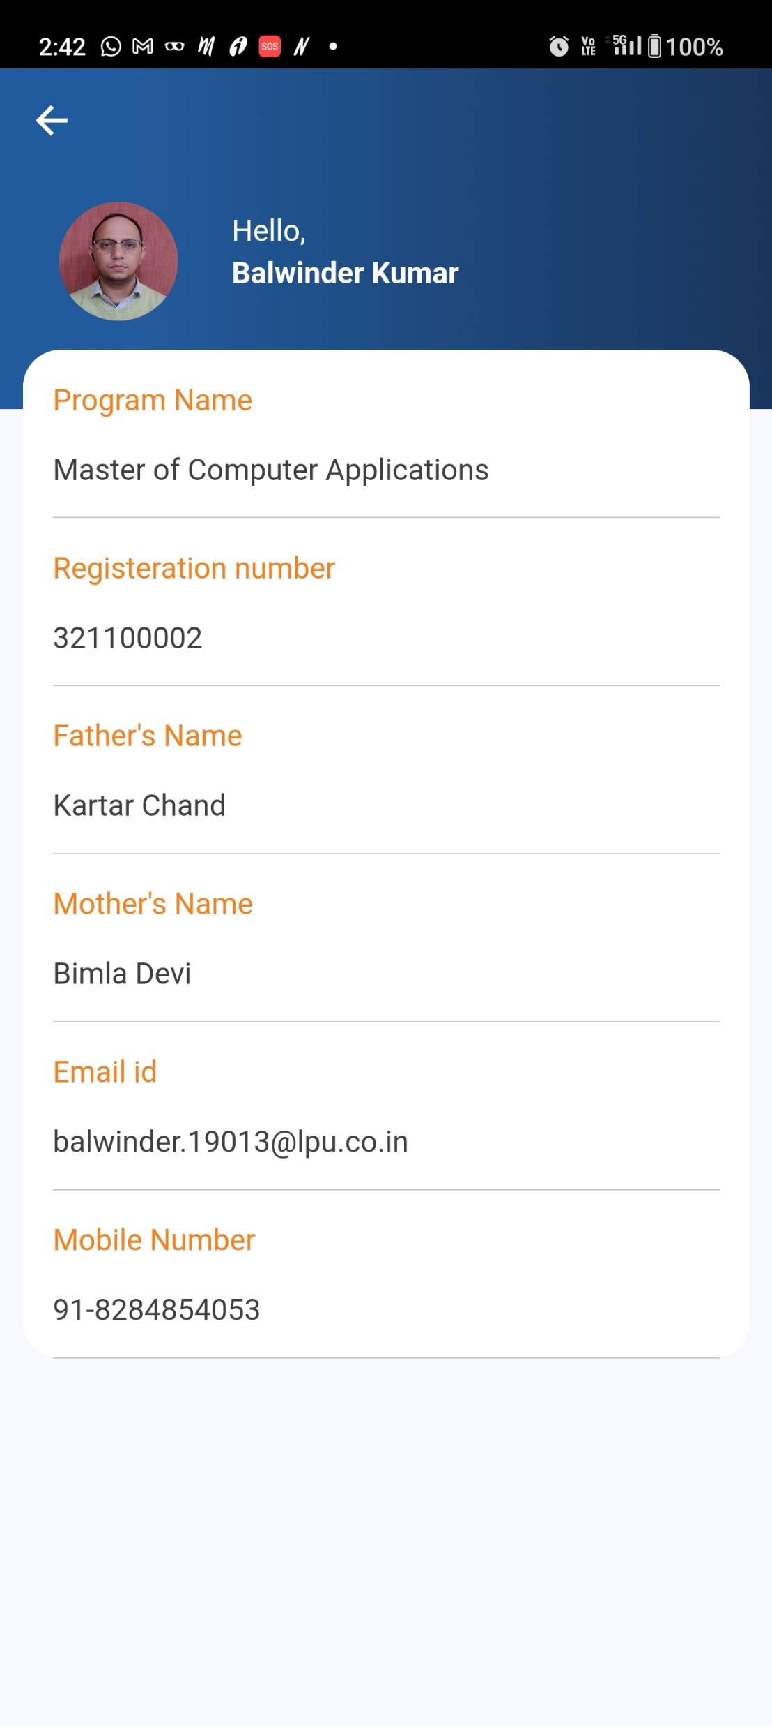
LPU e-Connect: Mobile App
Student Profile and Overall Progress
Dashboard
Student Profile
LPU Happenings
Quick Links

Slide 65
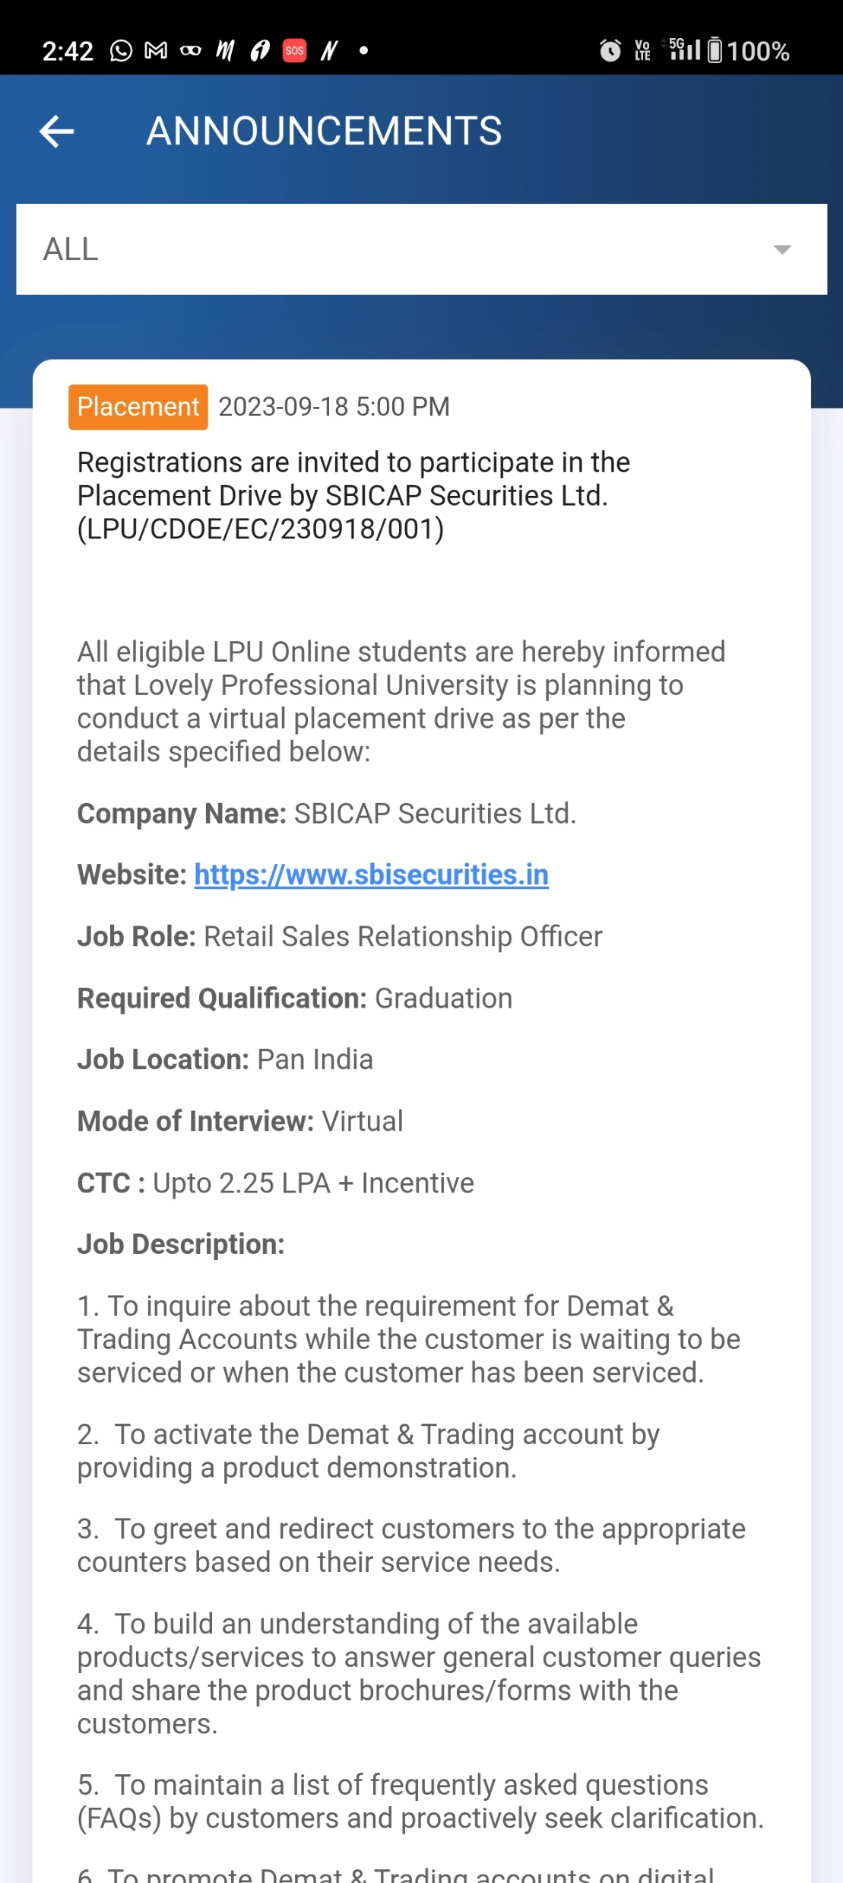
LPU e-Connect: Mobile App
Announcements
Click to access Announcements

Slide 66
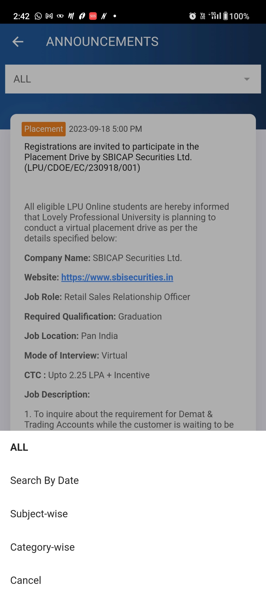
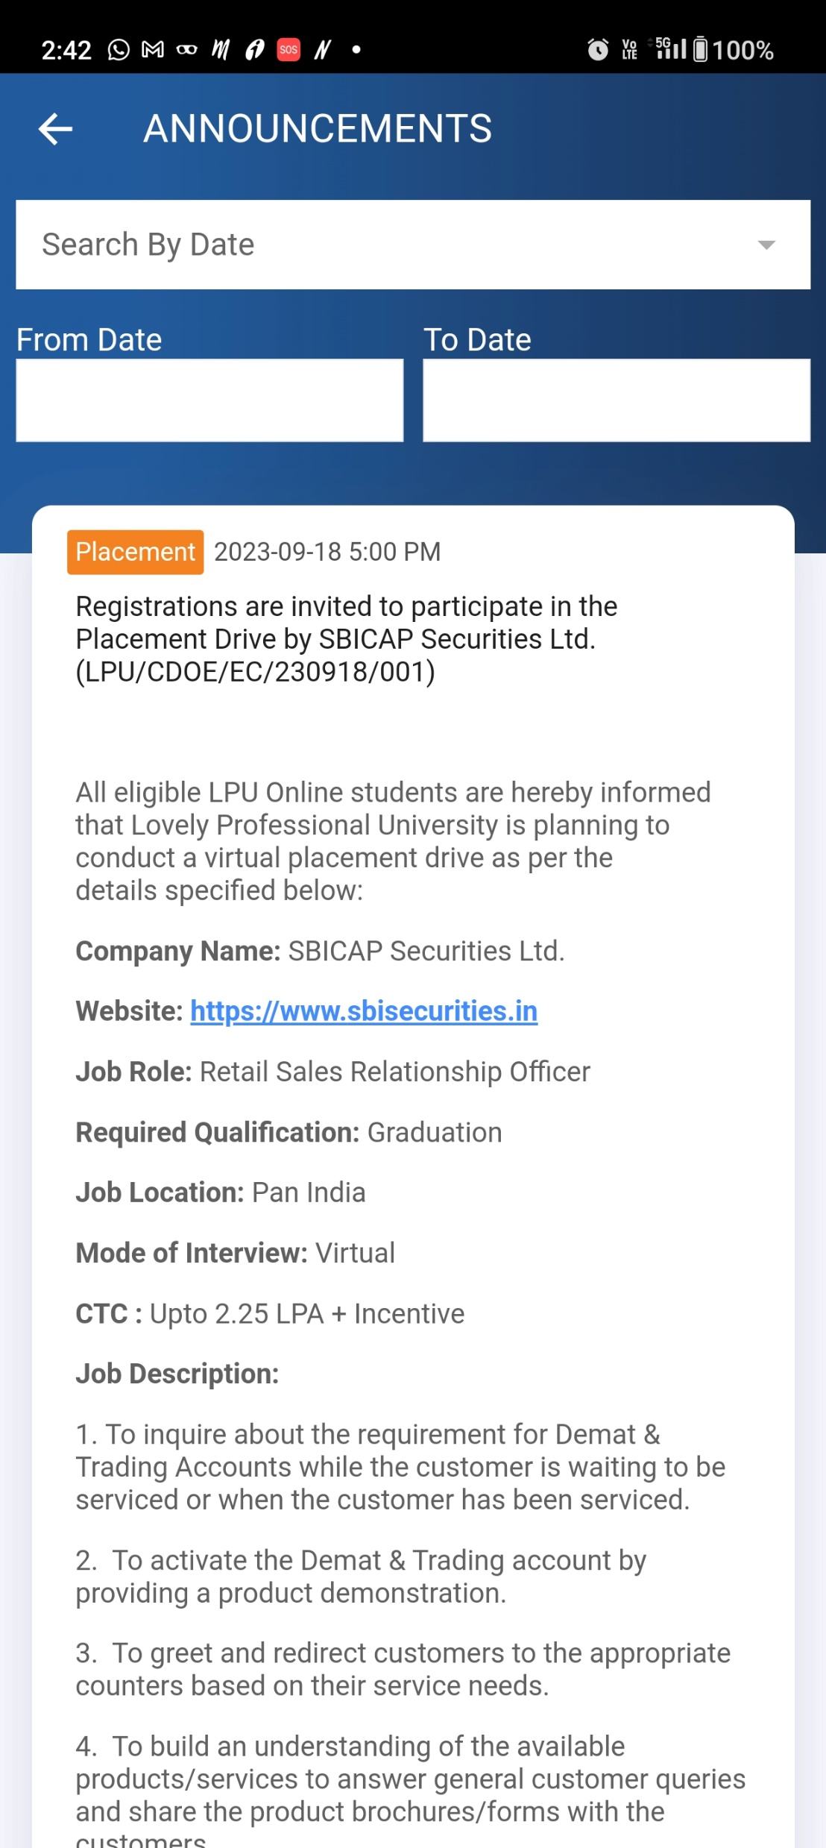
LPU e-Connect: Mobile App
Announcements Search
Search announcement by date
Various categories to search announcement

Slide 67
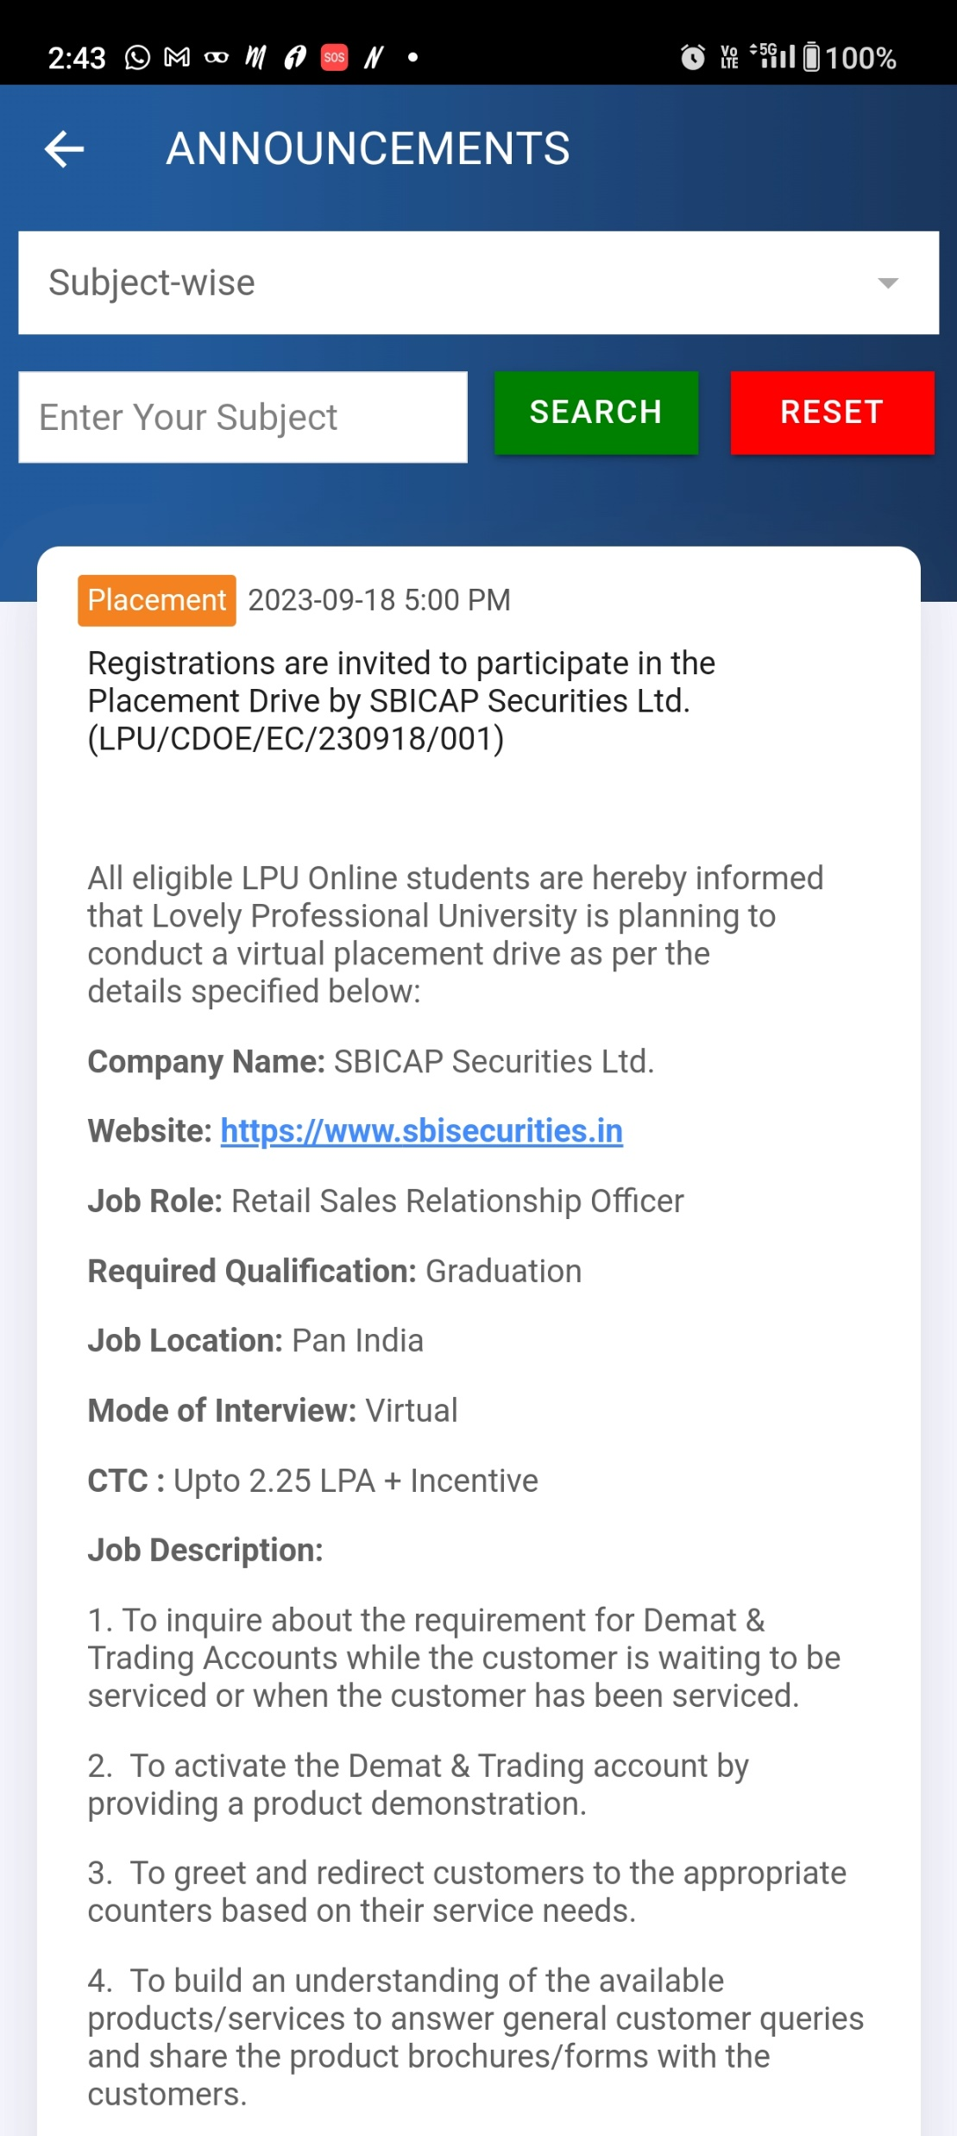
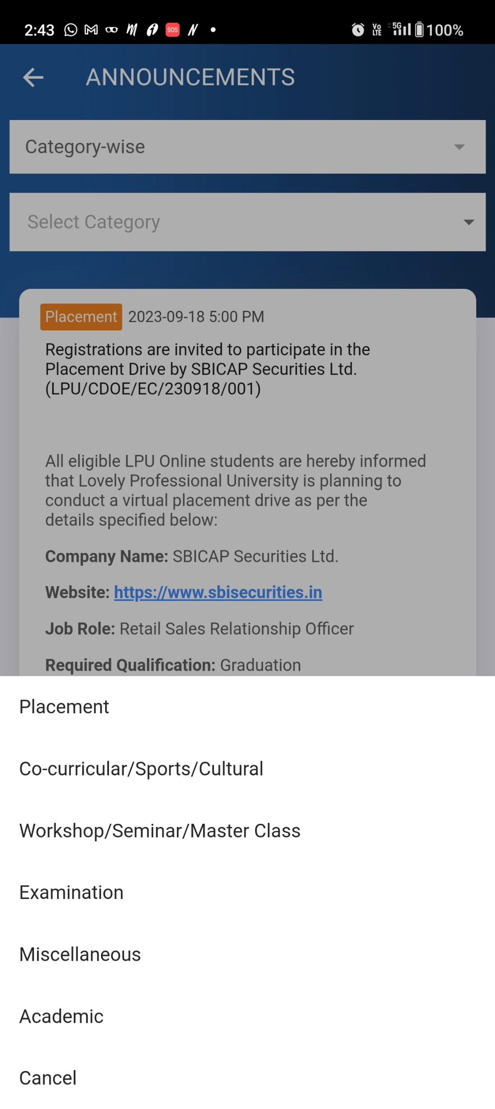
LPU e-Connect: Mobile App
Subject wise Announcement
Category wise Announcement
Search announcement by entering the subject
search by selecting the category.

Slide 68
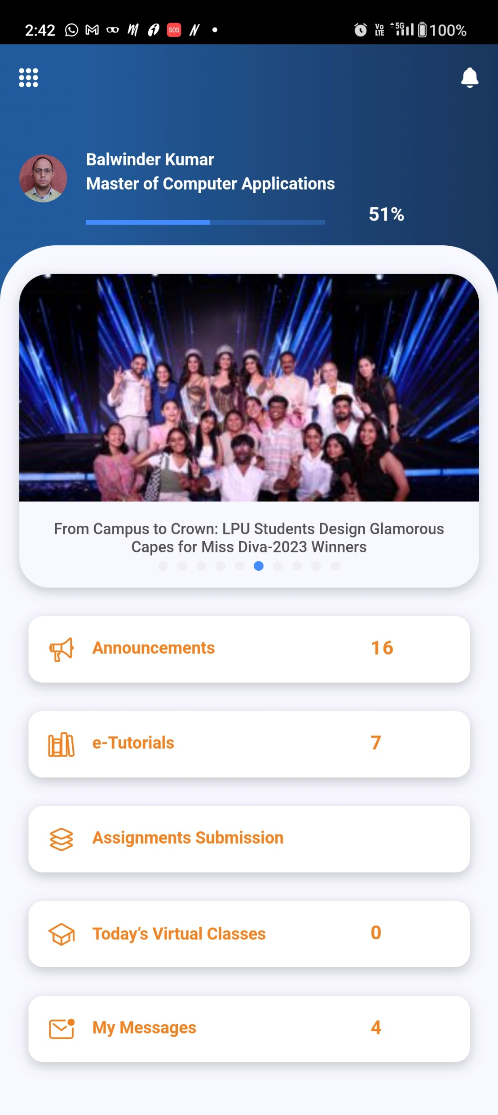
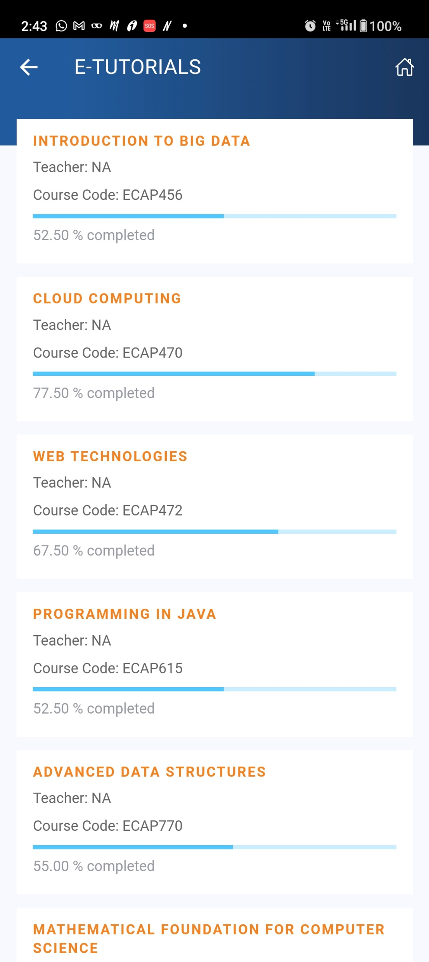
LPU e-Connect: Mobile App
e-Tutorials (Pre-Recorded Lectures )
Click on any Course tile to go to course content page
Click to access Course wise Recorded Lectures

Slide 69
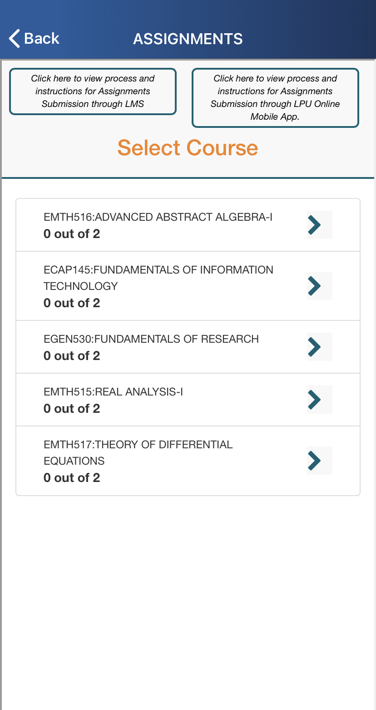
LPU e-Connect: Mobile App
Instructions to upload assignments using App
Assignment Submission
Course wise Assignments
Provision to Download and Submit solved Assignments
Instructions to upload assignments using LMS
Click to access course wise Assignments
Courses of Registered Term

Slide 70
LPU e-Connect: Mobile App
Today’s Virtual Classes (Time Table)
Weekly Time Table
Click to access time table

Slide 71
LPU e-Connect: Mobile App
e-Communications
My Messages (Personalized)
Messages posted by University
Click to access Personalized Messages

Slide 72
LPU e-Connect: Mobile App
Quick Links
Other Quick Links
Click to access other interfaces
Quick
Links

Slide 73
LPU e-Connect: Mobile App
ID Card
Click to verify ID Card through website
Click to view ID Card

Slide 74
LPU e-Connect: Mobile App
E-Books
Click on “Semester” to expand course wise e-books tiles
Click on Course tiles to access e-books
Click to Change Password

Slide 75
LPU e-Connect: Mobile App
Programme Guide
Virtual Classes
Click to Attend Virtual classes
Click to download Programme Guide
Link to attend Virtual Classes

Slide 76
LPU e-Connect: Mobile App
Exam
Online Platform
Link to Online Proctored Examination
Click to give exam (to be active during examination)

Slide 77
LPU e-Connect: Mobile App
Academic Calendar
Click to download the Important Dates as PDF file
Click to download the List of Holidays as PDF file.
Click to view List of Holidays & Important Dates

Slide 78
LPU e-Connect: Mobile App
Contact Us
Important Contact Details of University
Link to access Contact details

Slide 79
LPU e-Connect: Mobile App
Change Password
Credentials of LMS and Mobile App will always be same
Click to Change Password

Slide 80
Thank you

